Slide 1
Results Cyrcé 23.09.2024
Measured arrays:
128 x 0.5 x 0.5 mm² array – ‘Array1‘
128 x 0.25 x 0.5 mm² array - ‘Array3‘

Slide 2
Changes in readout process
New software version developed by me; easier to adapt to versatile situations (e.g. the new channel assignment change)
Should also be ready for 2D arrays (eventually also translated 2D arrays, but in that case I might add some function)
New in measurements: We have a not linear channel assignment (compare next slide)
The live results are harder to interpret, which means I will try to provide a LiveView for the next measurements that can be integrated into Stéphanes Tkinter measurement GUI

Slide 3
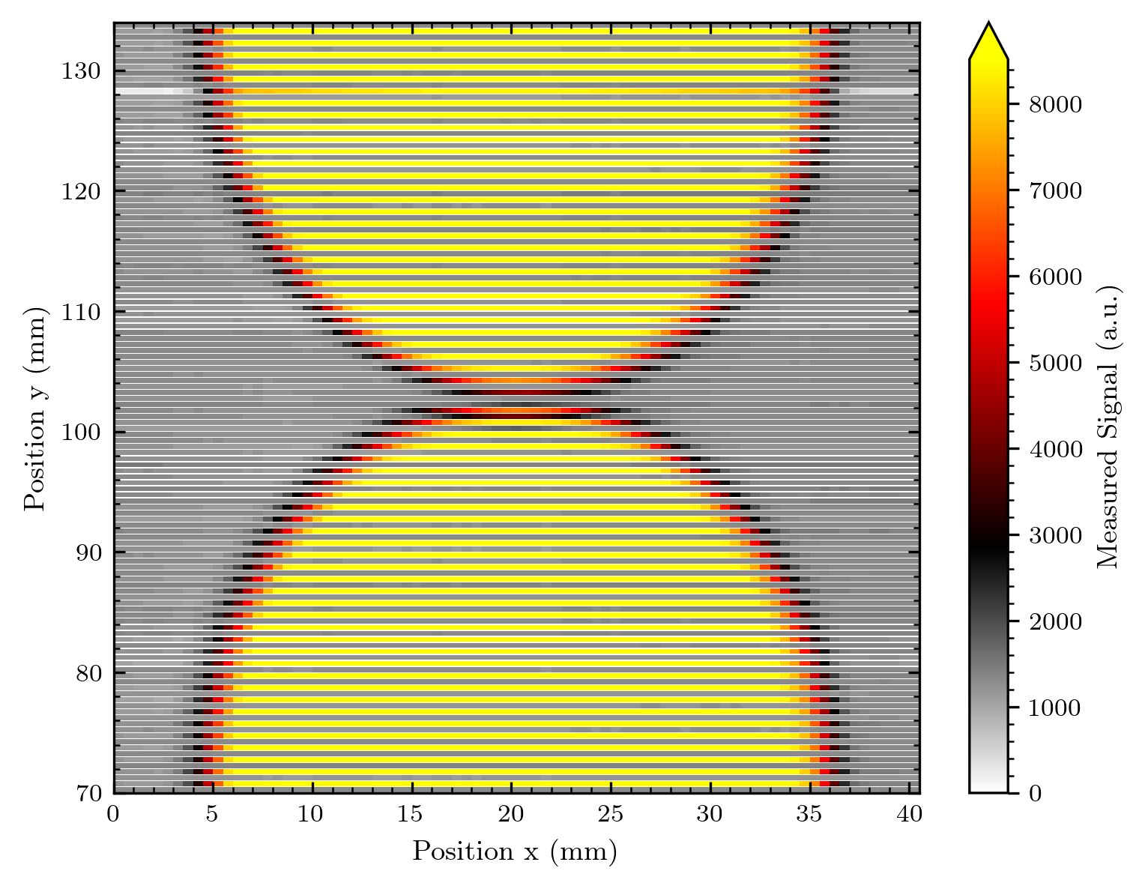
What we see if we image the raw data

Slide 4
Diode i ≠ Channel i
There is an assignment from the bonding (seems to be the same for both arrays imaged)
The assignment was provided in an Excel file by Stéphanes collegue
I adapted the readout – we‘re now flexible to any assignment, as long as we get something like an Excel list

Slide 5
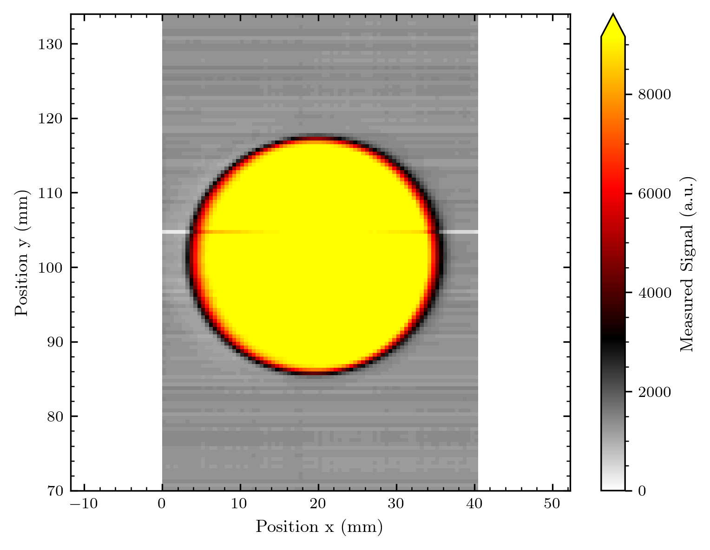
Correct assignment + Realistic Scaling

Slide 6
Slight change in my imaging code
These are now added!
To concern you with some technical details of my plotting routine:
For the 128-diode array I faced an optical problem when plotting the data:
The result is of course not a quadratic picture, thus the imaged shape is portrayed distorted
Thus, I now scale the axis on the same length (and currently the plot dimensions are height = Width / 1.3 – this compensates for the space of the width taken by the colorbar on the right)
This of course adds a white space in the plots, keep this in mind!
I haven‘t considered this so far as the older images from 64-diode arrays were nearly quadratic…

Slide 7
Changes on intensity scale
Since the intensity is extremely homogeneous and nearly no artefacts are present – I use the full signal range for the colour scale. So far I limited the max intensity colour to 90 % or even adapted the scale by hand to avoid artefacts distorting the signal colour! This is not necessary any longer!

Slide 8
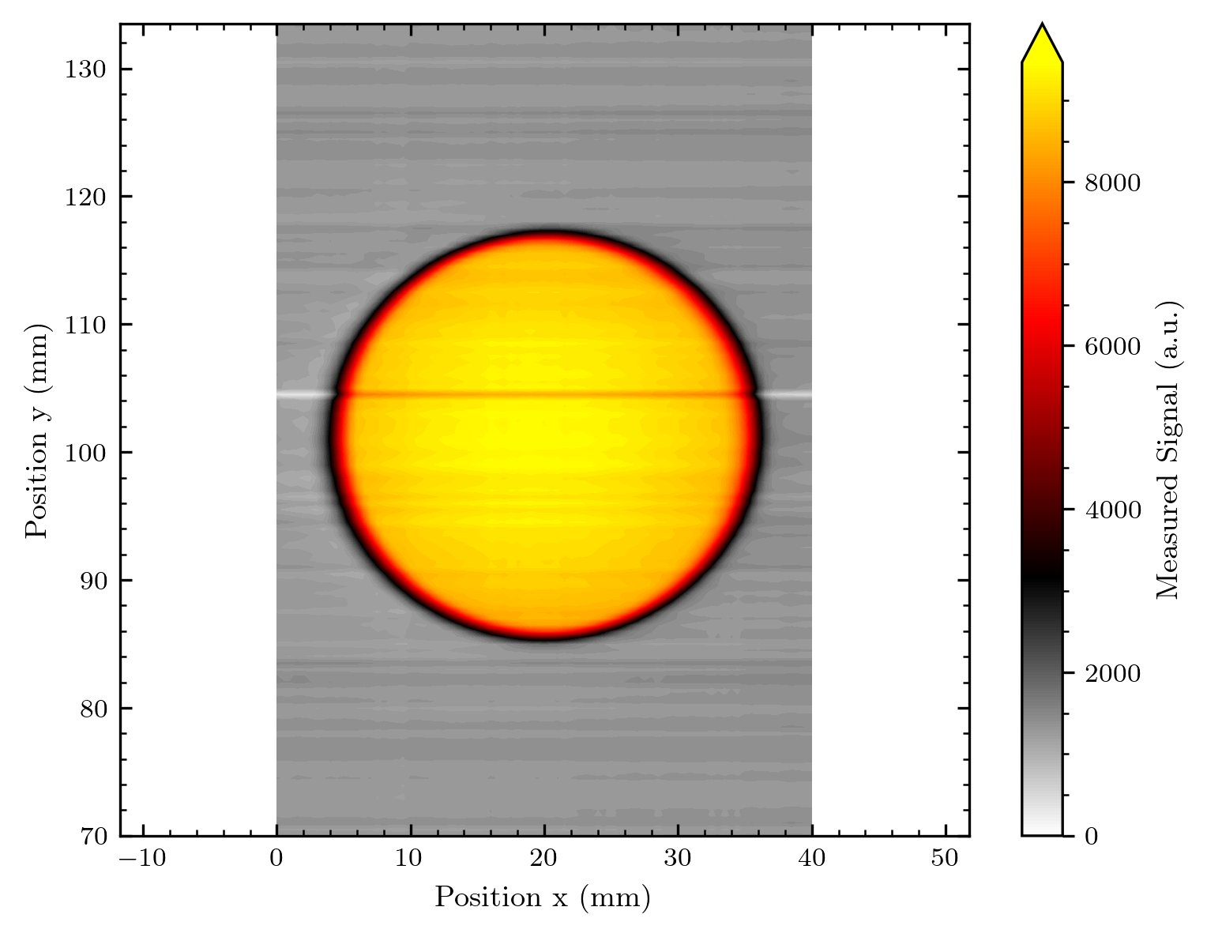
Changes on pixel imaging
I plotted the images differently: 1st with real pixel sizes and white spaces inserted for the diode spacing and 2nd as a contour plot – meaning each signal values are assigned to each point and values in between are interpolated. I now add an intermedium step, filling the white pixels with interpolated values.
White spaces
Interpolated pixels
Contour
Pixels (Matplotlibs pcolormesh for both)
Interpolation (Mpl‘s contourf)

Slide 9
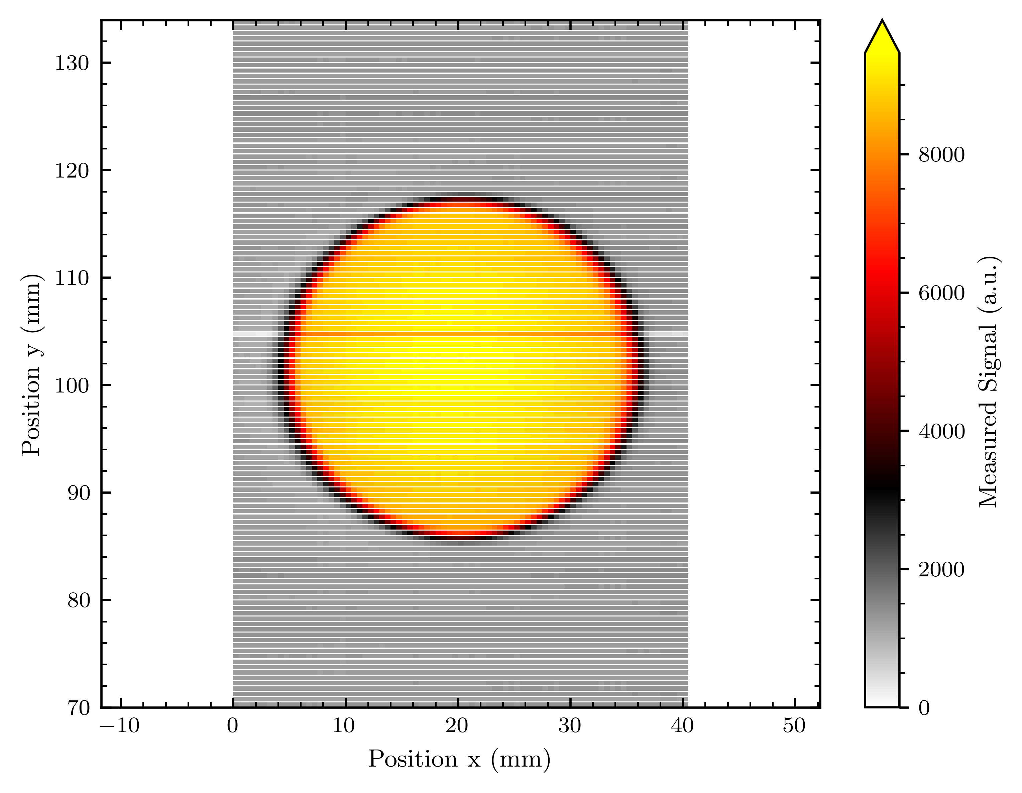
Important note (and future change?)
The contour plots have to be saved as .png, as .pdf their size is too large.
The pixel plots should currently be saved as .pdf; their size is still ~ 300 – 500 kB. In a compressed format as .png, a problem concerning the pixels occurs: In my current code the pixels are not equally sized, and this leads to a distortion (compare below).
Until I adapt the code, I stick to save formats as mentioned above.
In a .pdf the single objects from pcolormesh are kept as created!
.png
In the .png, the upper lines are indeed smaller than the lower, which is of course not a real display!
.pdf

Slide 10
What we measured
Voltage tests (dark and with signal) for both arrays: From 0 to 2 V
Y translated measurements over diffused beam: For normalization respectively check if the diode's response is homogenous
Images of round aperture, logo, misc shape, Bragg shape and undiffused beam (‘Array1‘) with 0.5 x translation steps at different regions of the array
logo, undiffused beam (‘Array3‘) with 0.25 x translation steps in one region of array
[The data now needs ~ double the data amount than before – meaning one map has ~ 150 MB or ~ 300 MB for the smaller steps]

Slide 11
Measurement conditions
Beam current for nearly everything: 2 nA on the array
(With diffuser ~ 2.43 nA at Faraday cup, without ~ 2 nA)
Bigger diffuser of 200 um (last times 40 um, where the beam was not flat)
We started with 400 um but the stray dose of diffused protons proved to be a problem for the labs above the beam room…
There was an extra 25 mm collimator 1-2 m before the one that we were using – not a huge impact but good to have in mind
In the morning (array 1: voltage check, images round aperture, logo, beam shape) the beam was stable; later it stabilized
I have noted the before after current of each measurement set and will later add this to the presentation

Slide 12
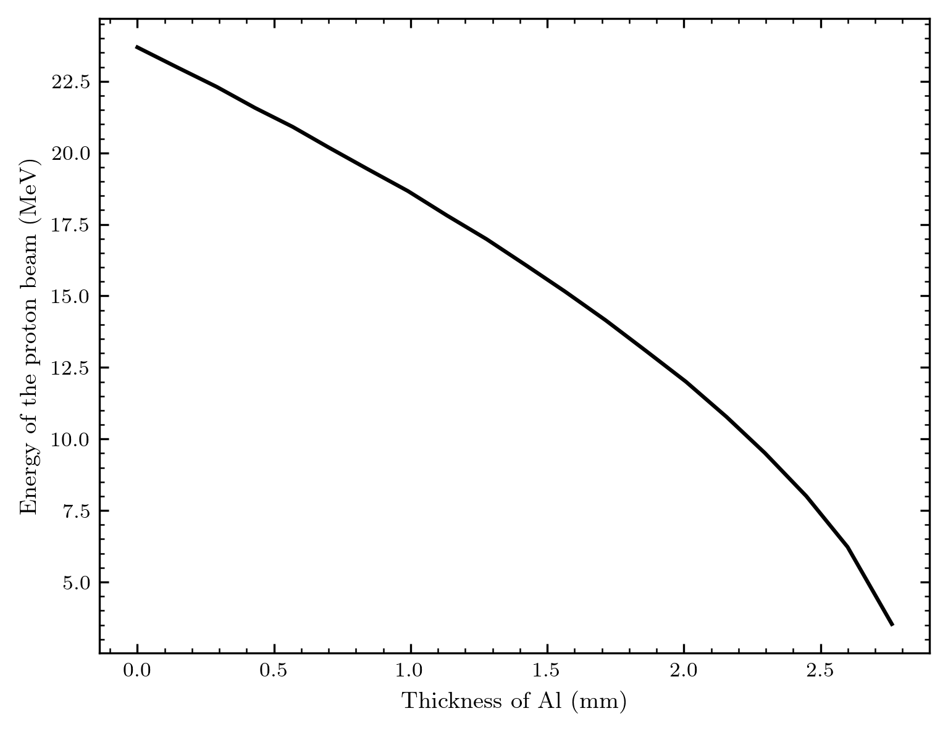
Details about the beam
Values we got from the Cyrcé crew for our measurements with the 0.2 mm Alu diffuser
Energy of the beam before the diffusor : 24.9145 MeV
Energy of the beam after the diffusor : 24.00744246796799 MeV
Energy of the beam at the 'sortie air' : 23.776482520861308 MeV
Protons behind collimator vs different Al thicknesses

Slide 13
Beam Current
Concerning the current – I noted the current at the Faraday cup
From the conversion that was mentioned 2.43 nA before our 0.2 mm diffuser (~ 0.823)
were 2 nA on the sample.
But there was this extra 25 mm collimator in the beam line:
This limited the beam to an aperture of ~ 30 mm instead of the total 36.51 mm. of the round aperture.
The currents measured were seemingly distorted by this collimator, we got some factors for this.
Coefficient d’étalonnage 15/25/36.5 diffuseur 200 : 0.9478 15/25/36.5 sans diffuseur : 0.9589
From my understanding (please correct me if wrong) this means:
The current we had on the sample, was the current I noted (and will add to each measurement) at the Faraday cup multiplied by the correction due to diffuser (if diffuser was used) multiplied by this additional factor from the collimator.
Thus 2.43 nA should have been 2 nA on the sample, but were 1.8956 nA on the sample
Keep this in mind for the later voltage measurements and comparisons I‘ll show you.

Slide 14
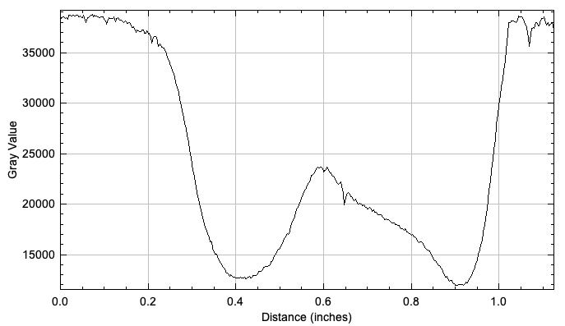
Beam films
We finally got the gafchromic images of the first measurement day! I will add these results to the previous measurements.
These graphs are a grey level scan of the irradiated films to get a quantitative value for the beam strength
HD
BG

Slide 15
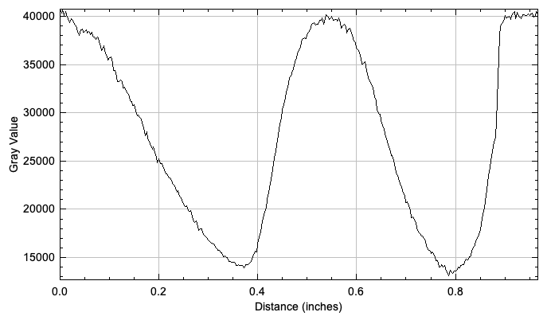
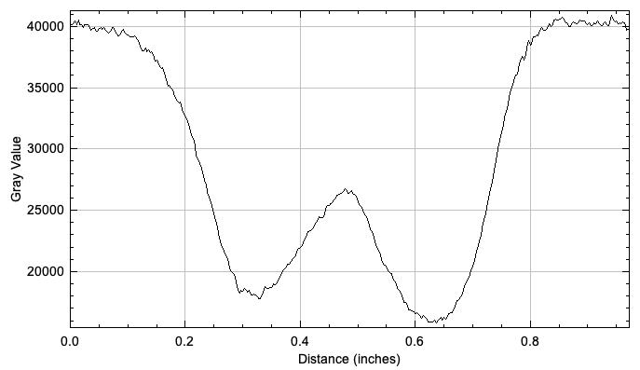
Still first measures ?!
G
D
G
D

Slide 16
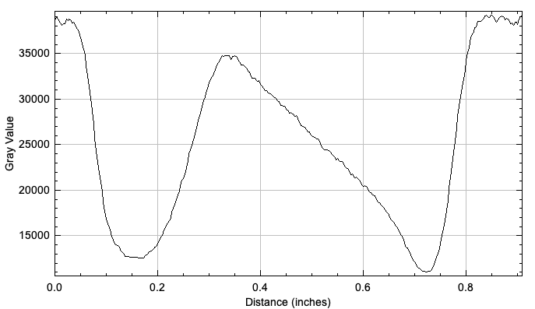
Sadly we do not have images from the 23rd September, but might redo this within the next measurement days!
Also from the first measurements this May?!
B
H

Slide 17
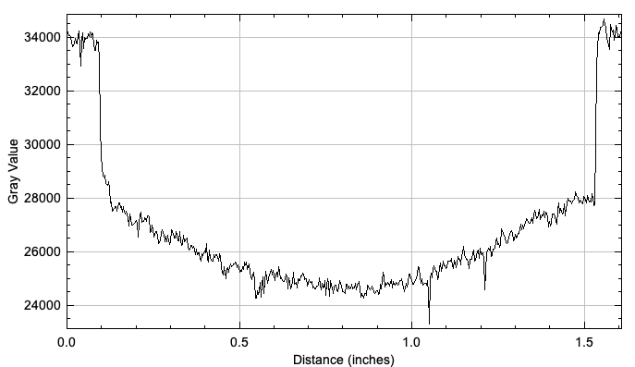
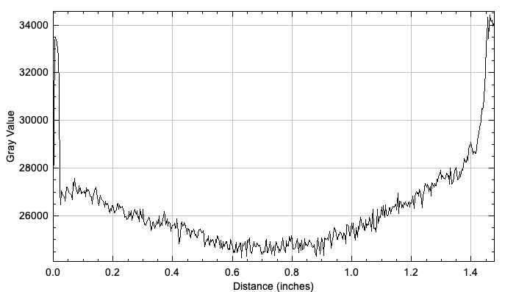
And we got similar scans for the diffused beam!
The 40 um diffuser?!
B
H
Looks homogeneous, but the grey scale shows the real distribution
D
G

Slide 18
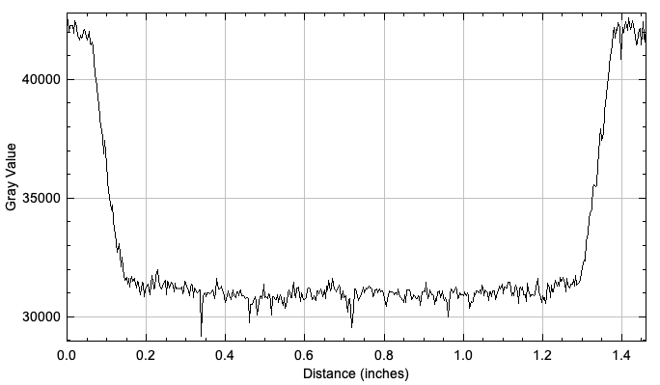
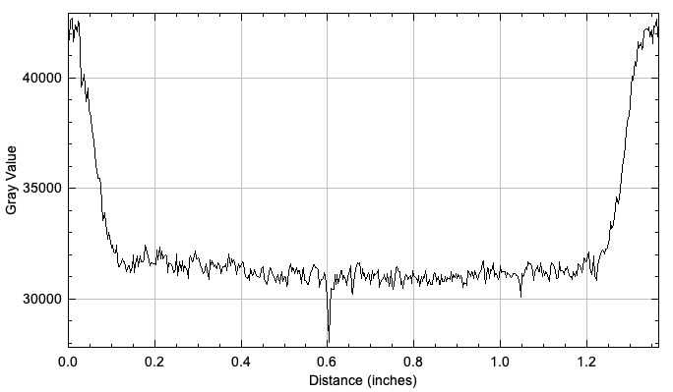
The 200 um diffuser used for these measurements!
H
B
G
D

Slide 19
My logbook
My raw notes are added as scan to the results folder, if you want to look up some measurement details!

Slide 20
Images – Array 1
So far without normalization, as I need to recheck and maybe re-adapt the code for this. Keep in mind that the diode response looks very homogeneous, but I have not verified this with the y-translated measurements yet.

Slide 21
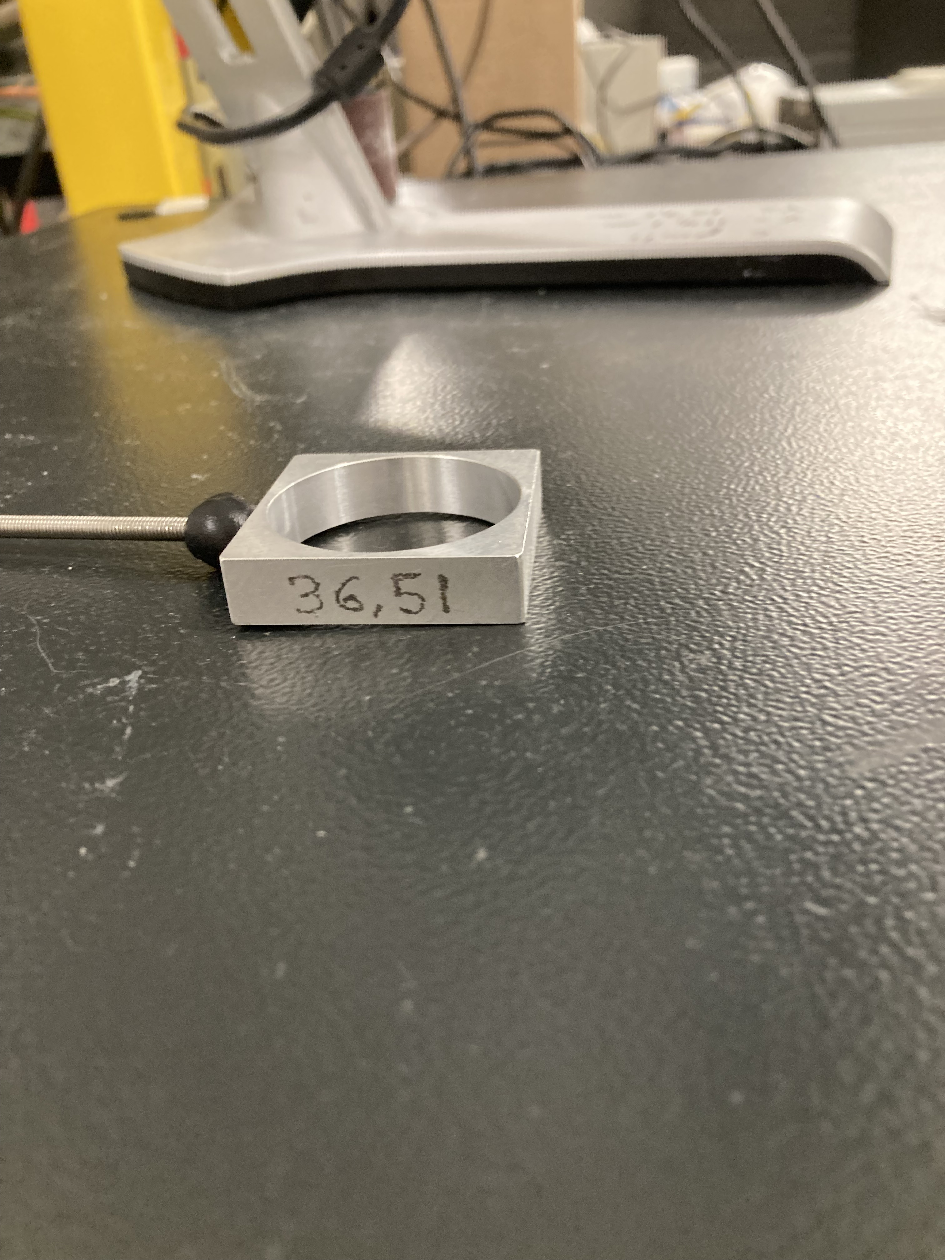
Further details
Array ~ 128 x 0.5 mm = 64 mm
We only cover a part of the array in one measurement – we thus decided to make a map for the upper part, middle and lowe part of array 1!
For array 3 the smaller step size made the measurements too time-consuming for the time we had left.
round aperture of
proton beam
ø = (36,51 mm)
~ 30 mm in reality

Slide 22
Background subtraction
In the images I already sent around the background was not subtracted! How are the images looking after doing this?

Slide 23
The quality without normalisation is perfect – as it seems! (But I still need to verify this with the y-translated data) There will be a lot of nice zero-white in the images!

Slide 24
Fanout (old) vs direct bond (new)
I‘ll add info to make the signal levels and other aspects easier comparable…
Note that the old images are a bit distorted, I‘ll apply the new scaling routine on them

Slide 25
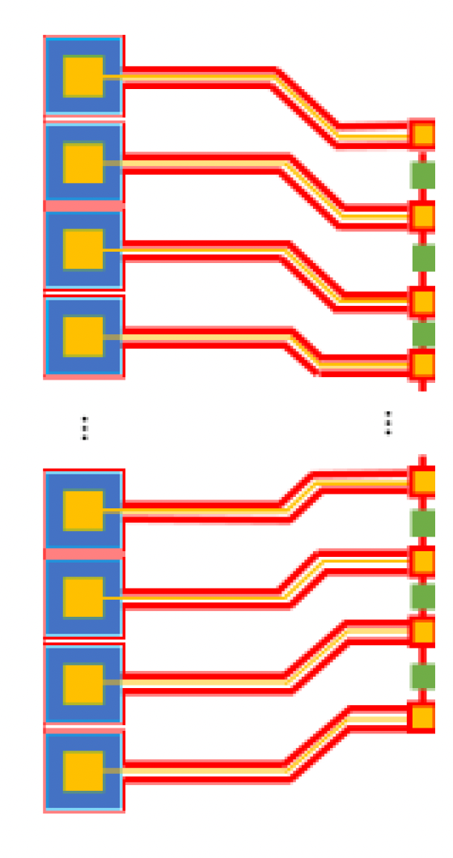
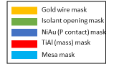
The difference in concept
Previous 64 diode arrays
Masks of new array generation – no fanout on GaN sample, direct bonding to PCB

Slide 26
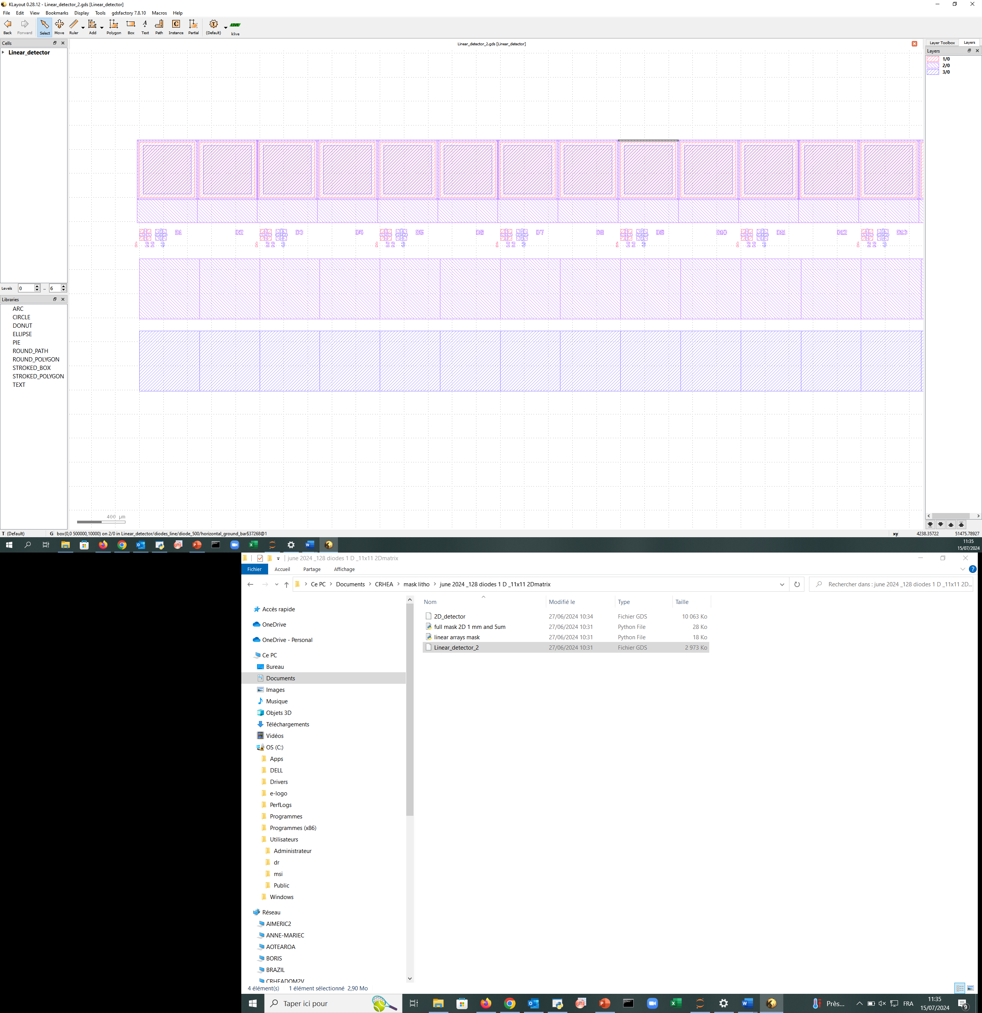
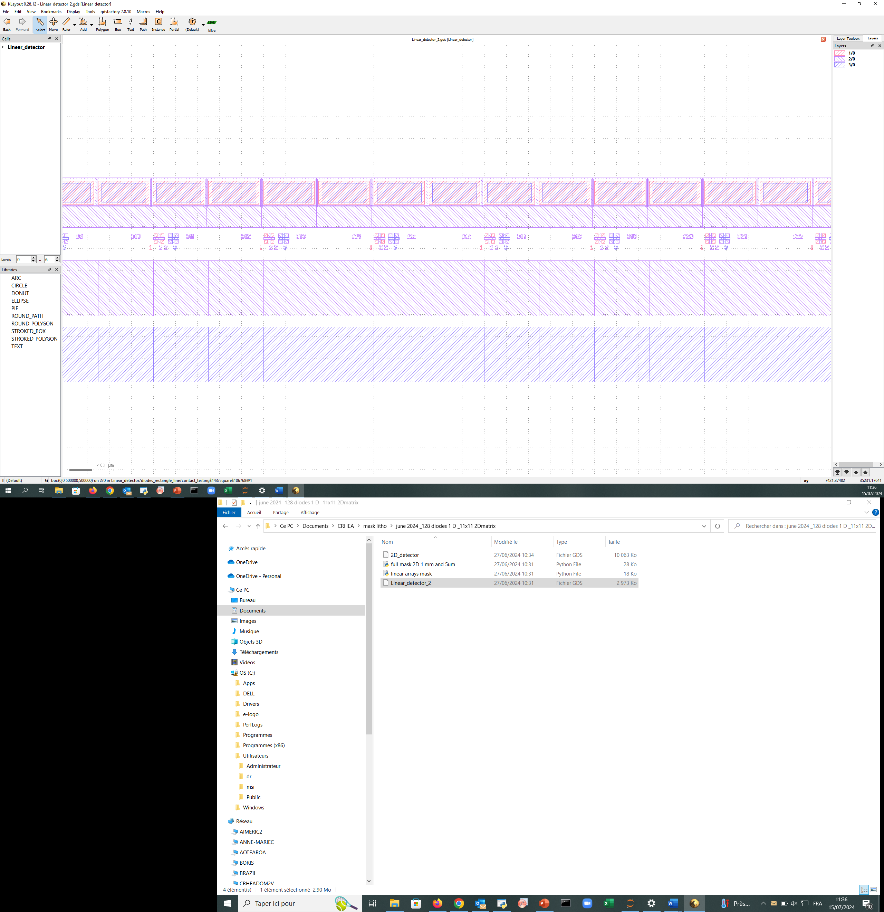
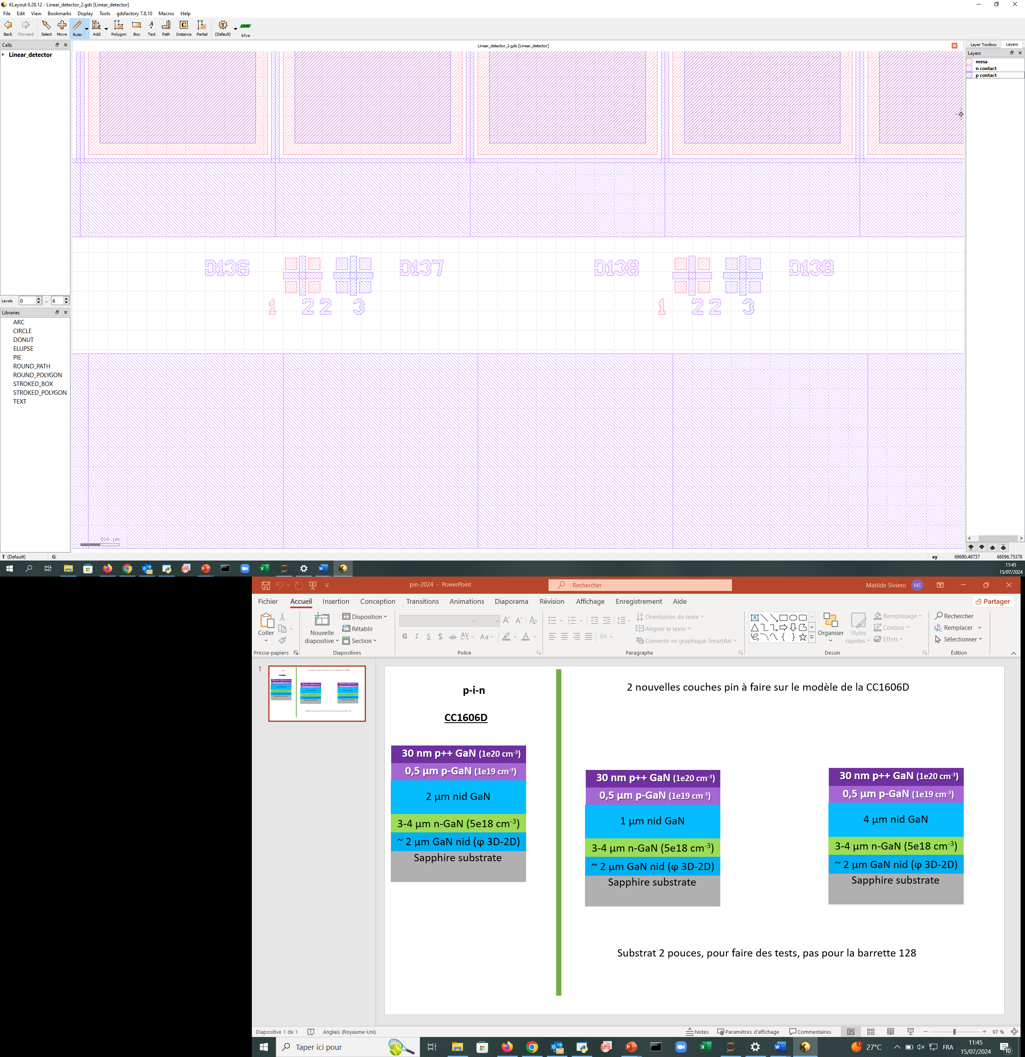
New diodes‘ dimensions
SINGLE DIODE
DIODES LINE (x140)
Maximum total length 500µmx140=7cm
500µm
10µm
Most measurements were done with this array – if not explicitly mentioned the results are from Array1!
400µm
500µm
400µm
20µm
30µm
128 diodes read out – here referred as: Array1
10µm
200µm
SINGLE DIODE
500µm
DIODES LINE (x140)
Maximum total length 500µmx140=7cm
250µm
170µm
400µm
200µm
128 diodes read out – here referred as: Array3

Slide 28
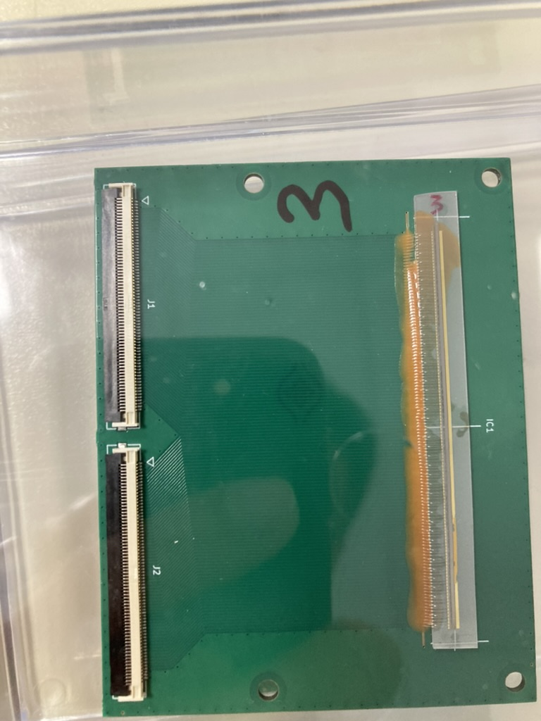
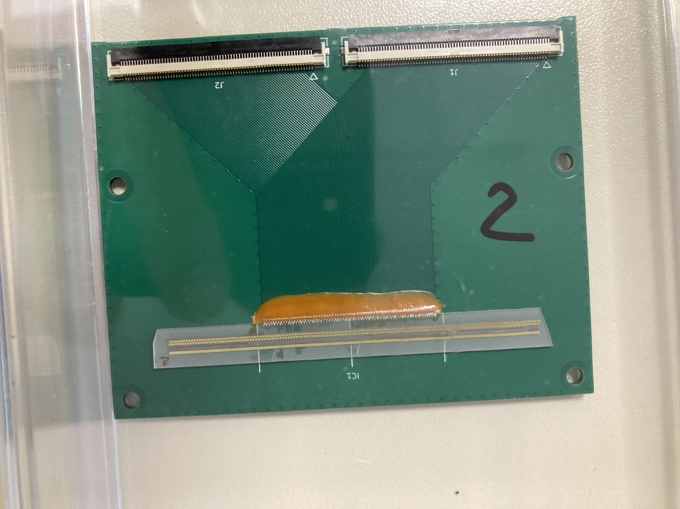
Array 3
Array 2 (not measured yet)

Slide 29
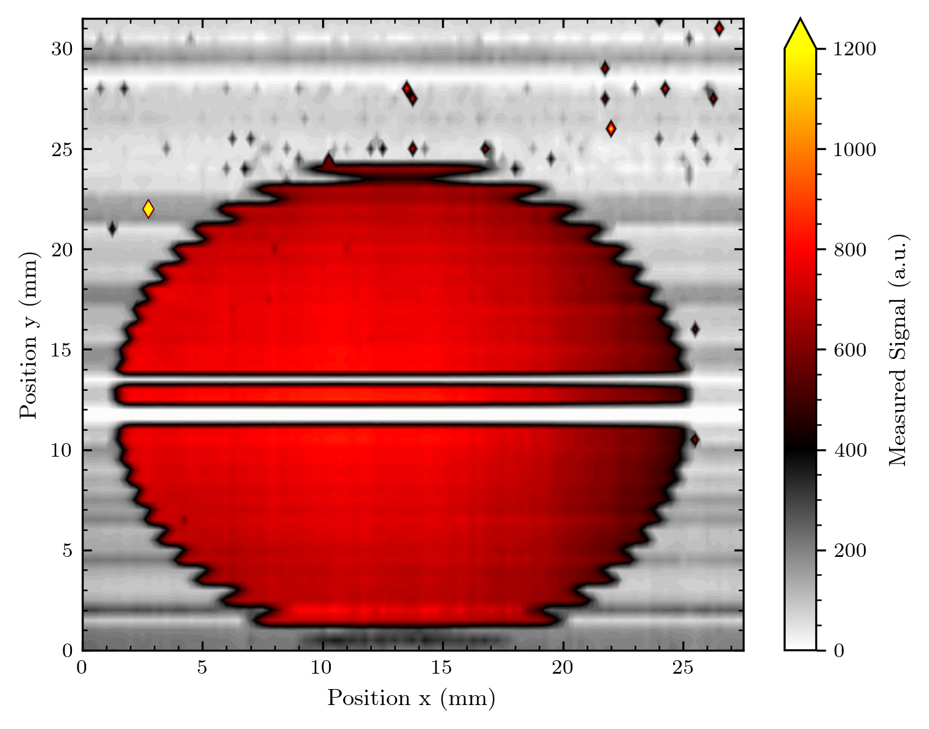
Round aperture

Slide 30
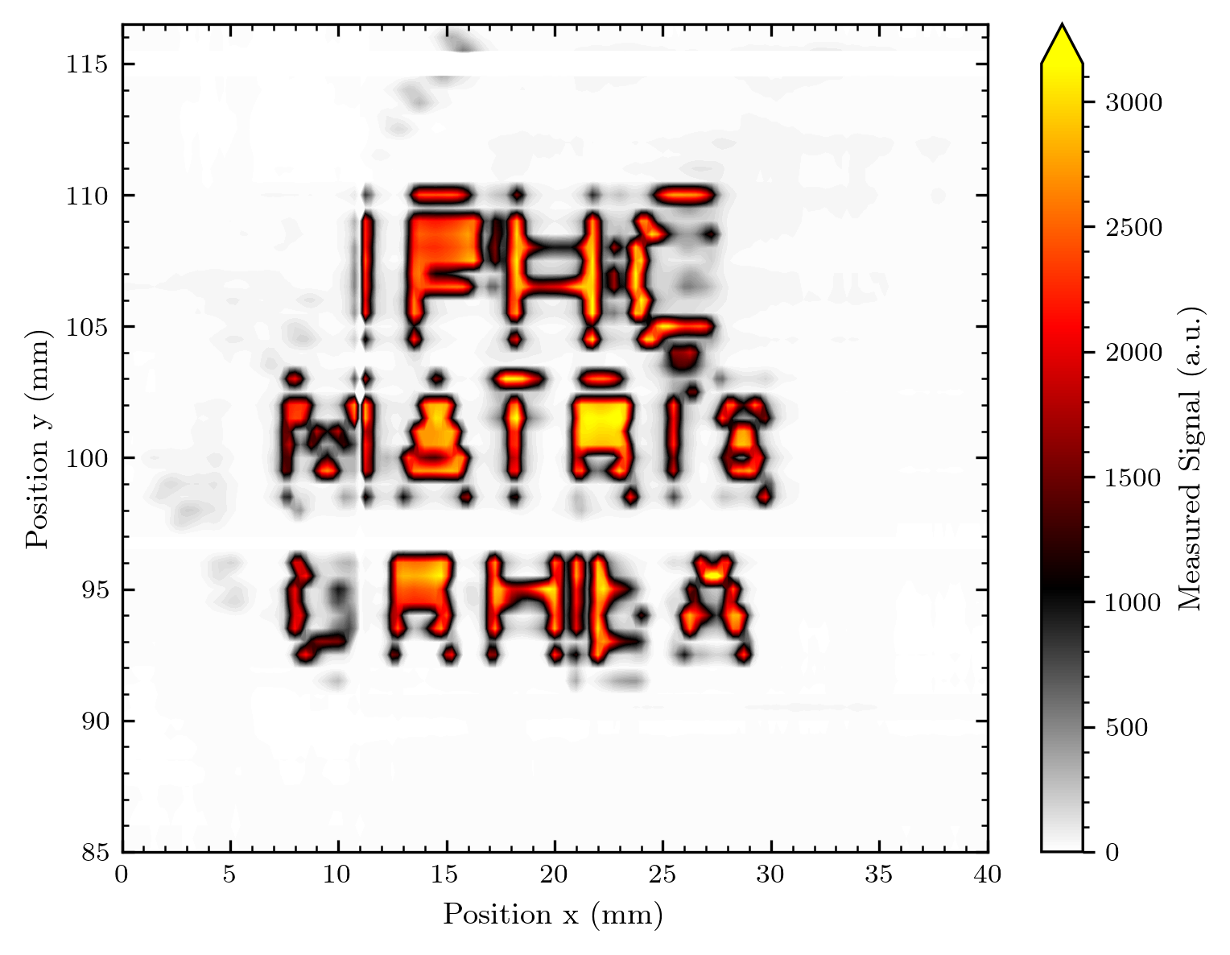
Logo

Slide 31
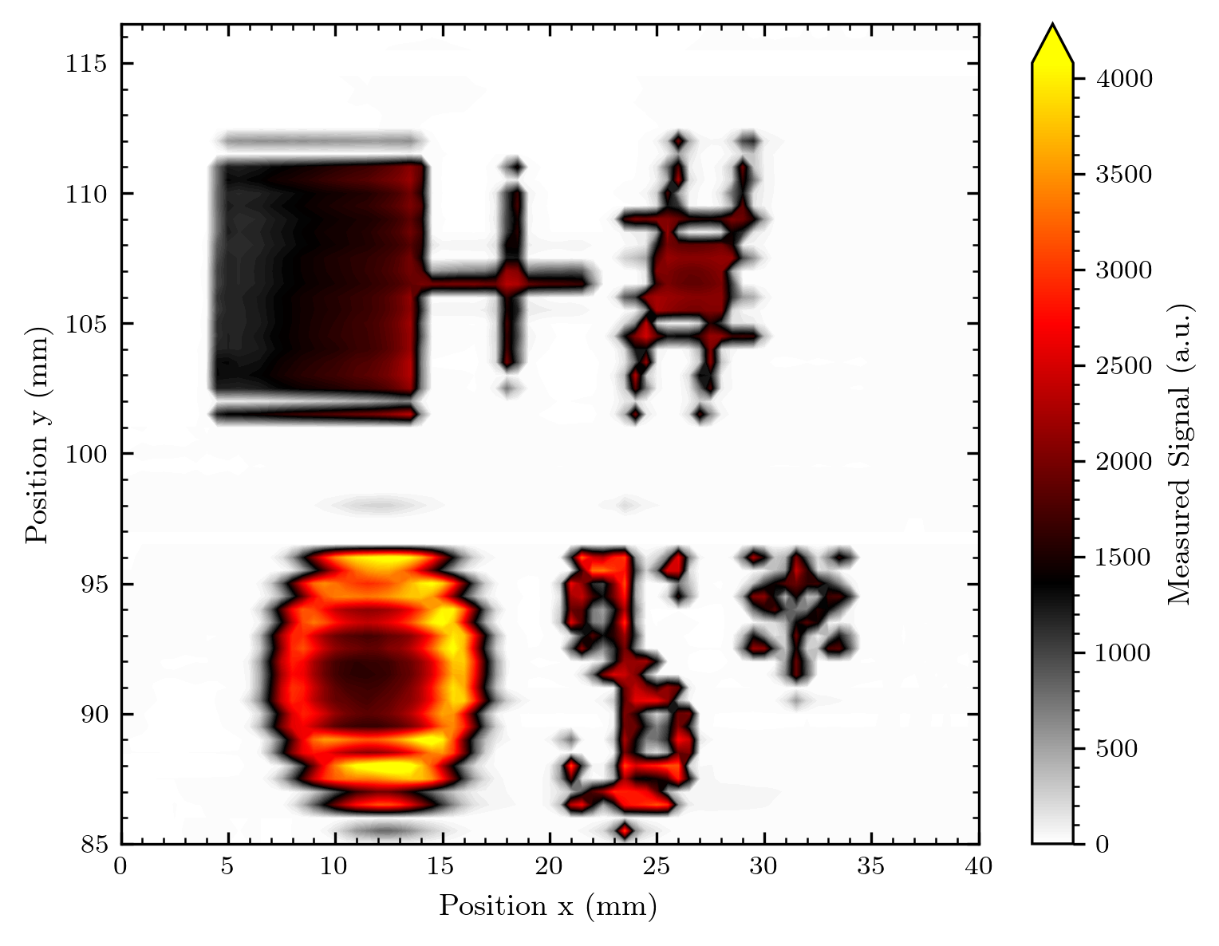
Misc shape

Slide 32
The protoemission has disappeared?!! Our imaging quality and reliability is drastically increased!

Slide 33
Maps
Only background subtracted
1st side measurement details + 1 map in real pixels (white space)
2nd side: Maps in pixel (filled)
3rd or 2nd side: Maps in contour

Slide 34
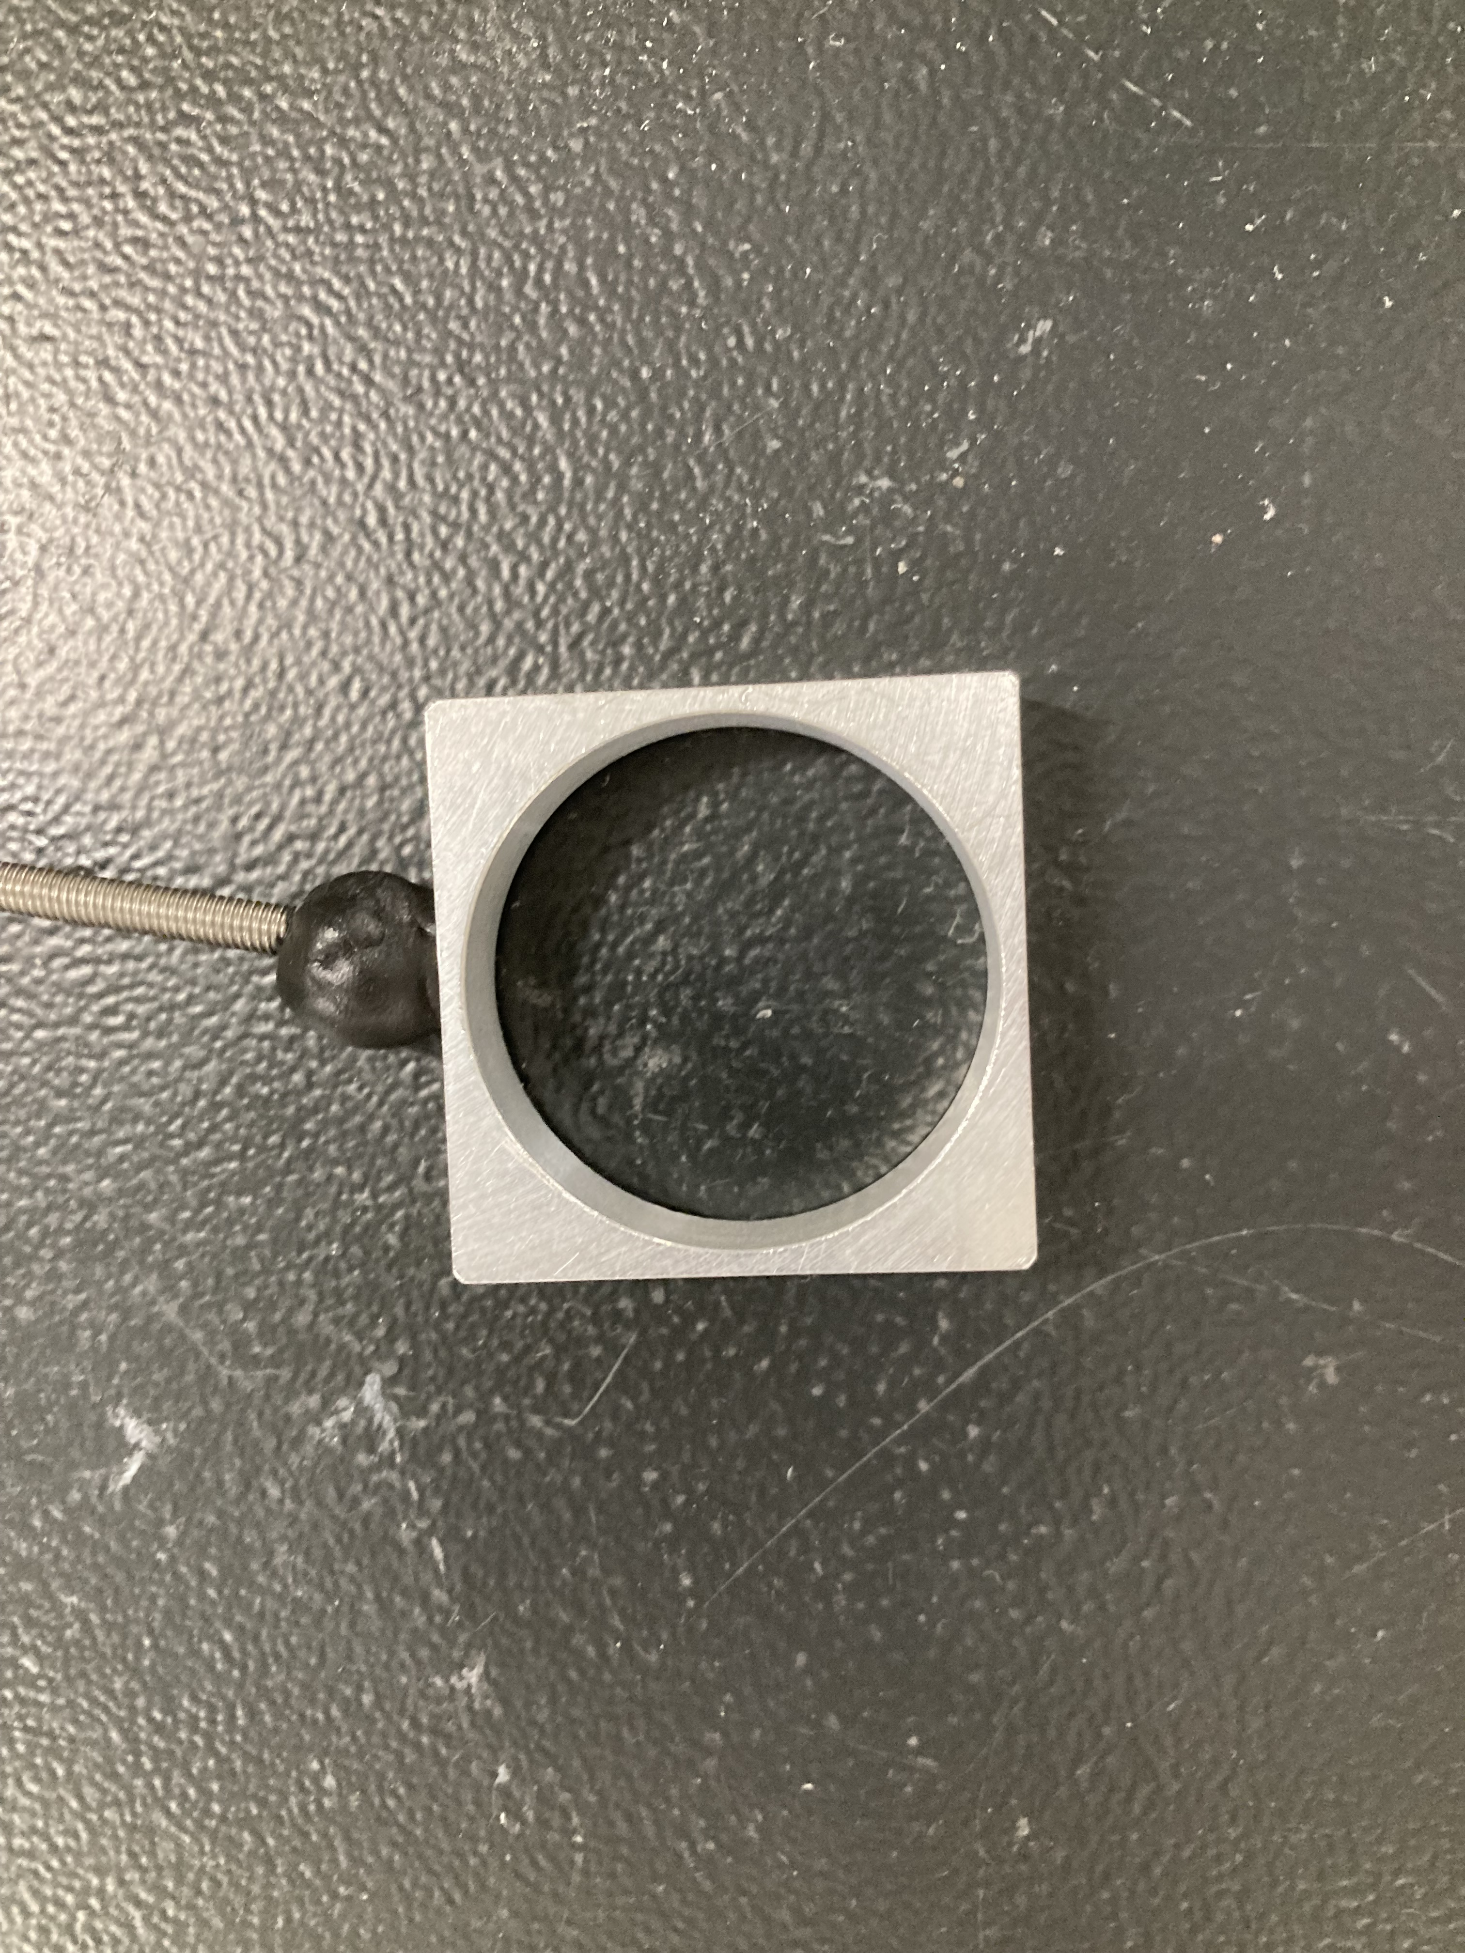
The round aperture
4 images (1 half out of the beam)
y = 40 mm: 2.43 nA -> 2.34 nA
y = 70 mm: 2.43 nA -> 2.36 nA
y = 85 mm: 2.41 nA -> 2.36 nA
y = 55 mm: 2.43 nA –> 2.38 nA

Slide 35
Sunrise of the proton beam ☺

Slide 36
y = 40
y = 55
y = 70
y = 85

Slide 37
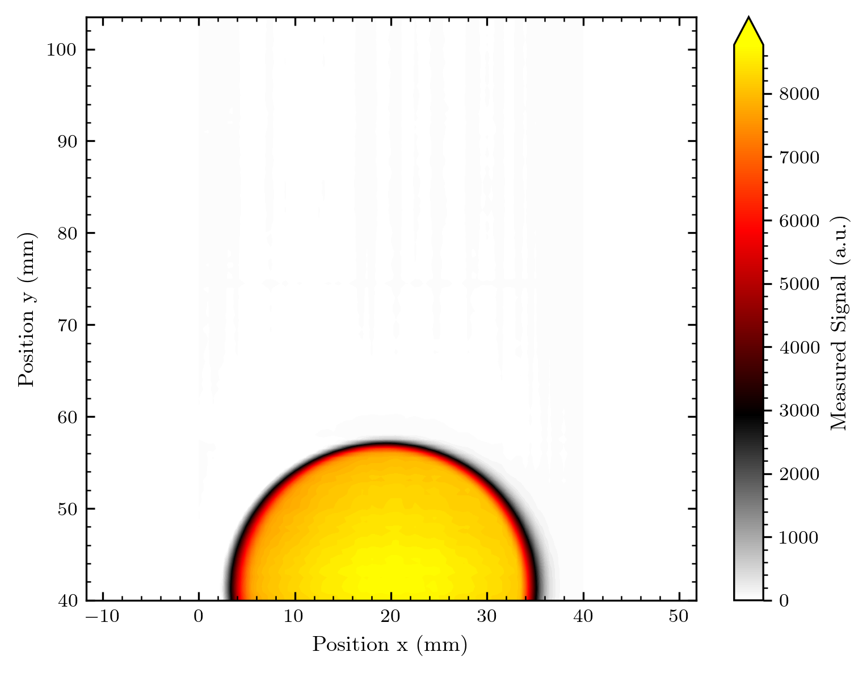
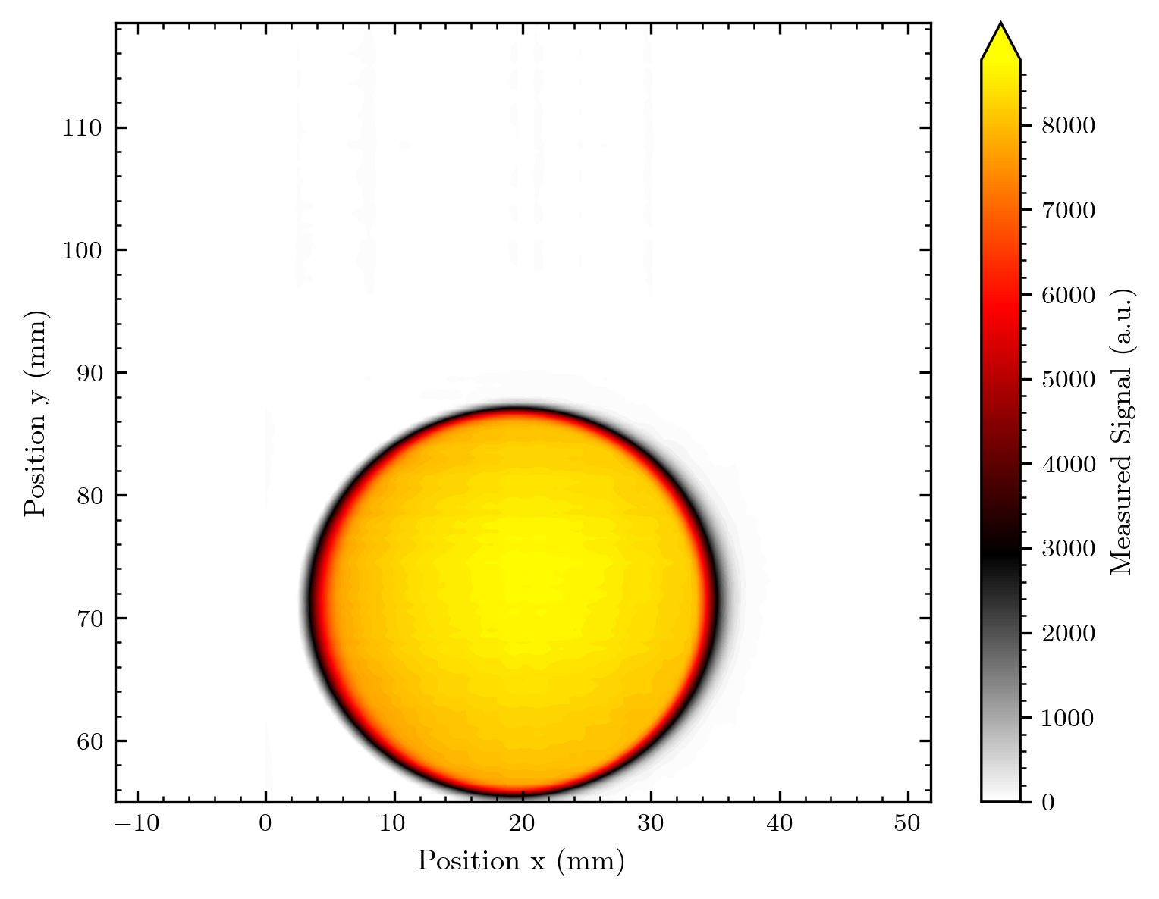
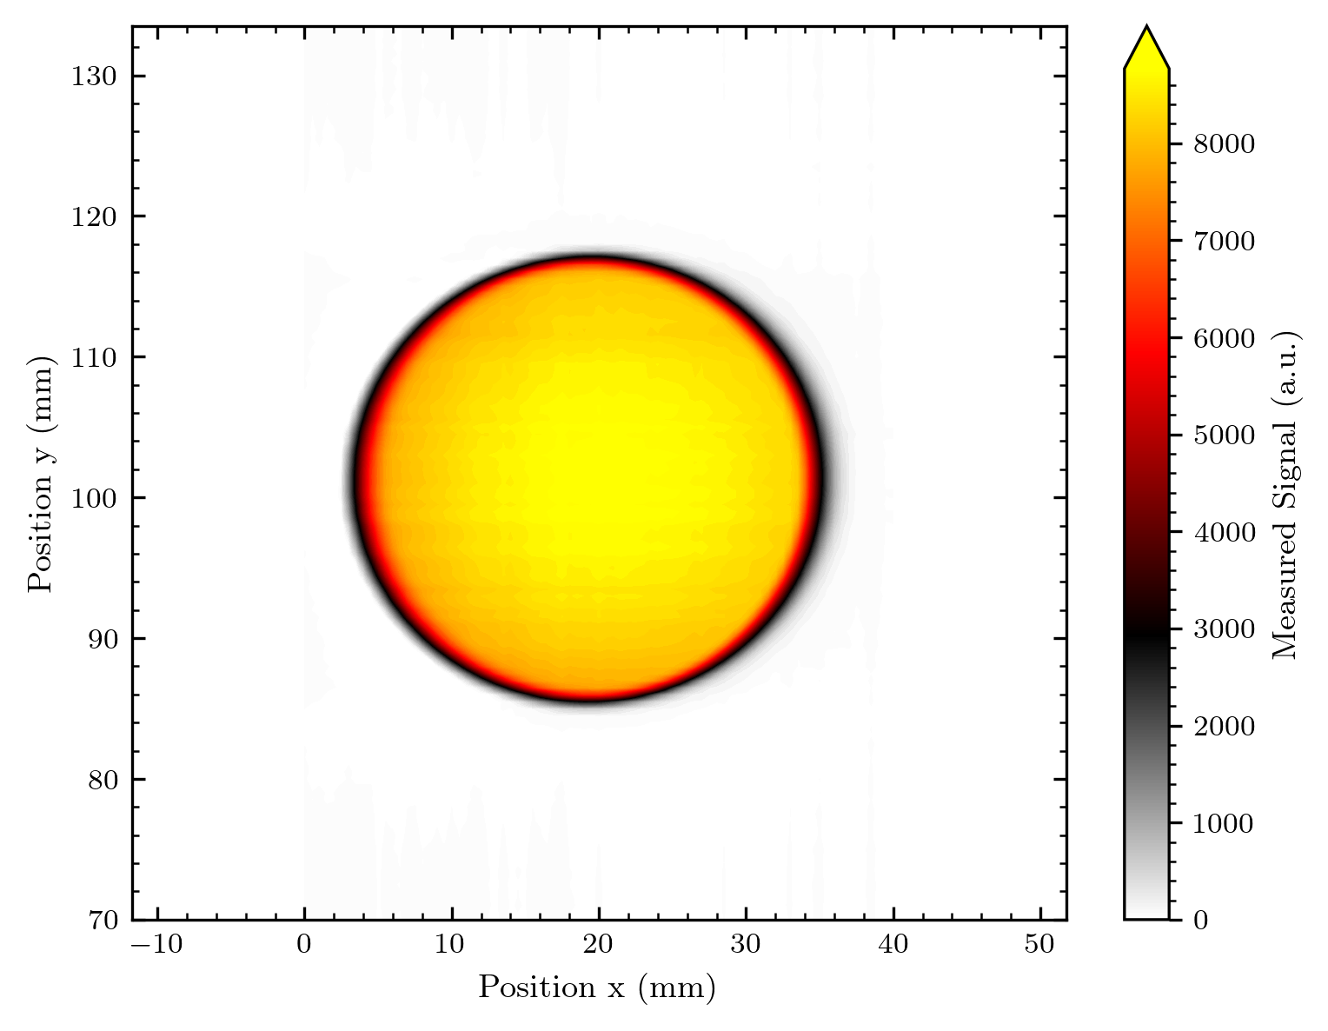
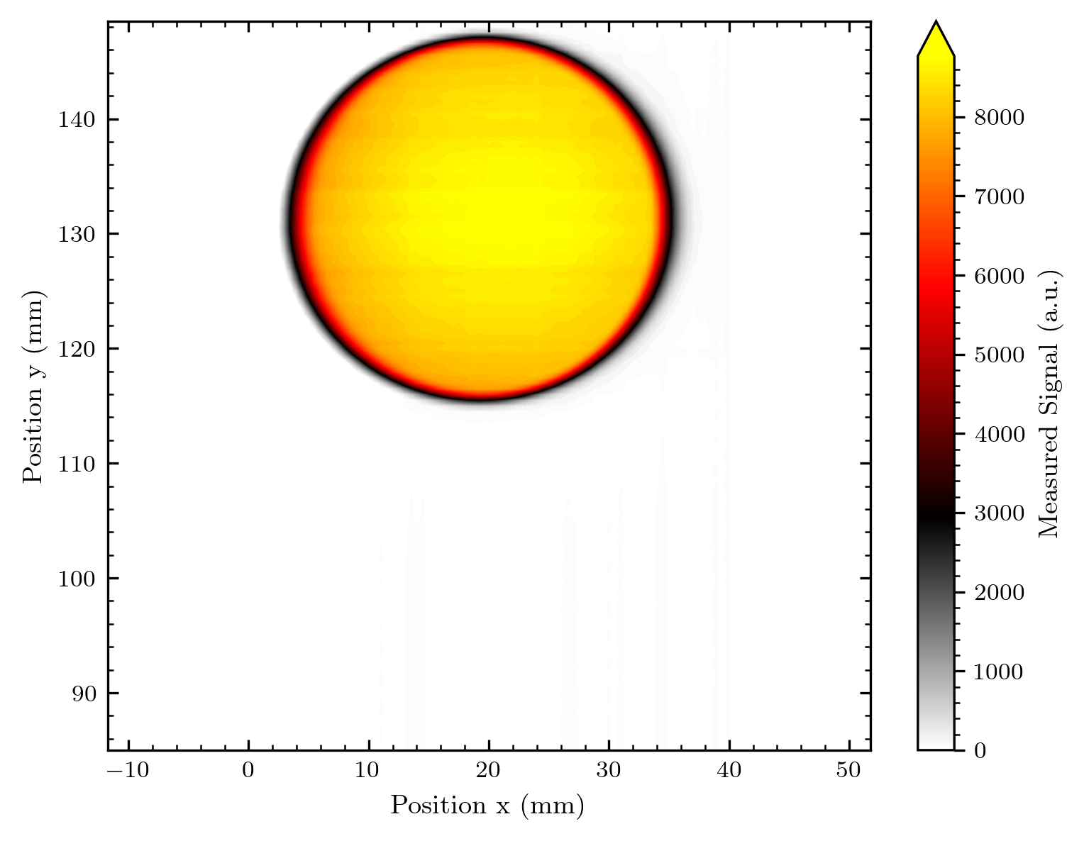

Slide 38
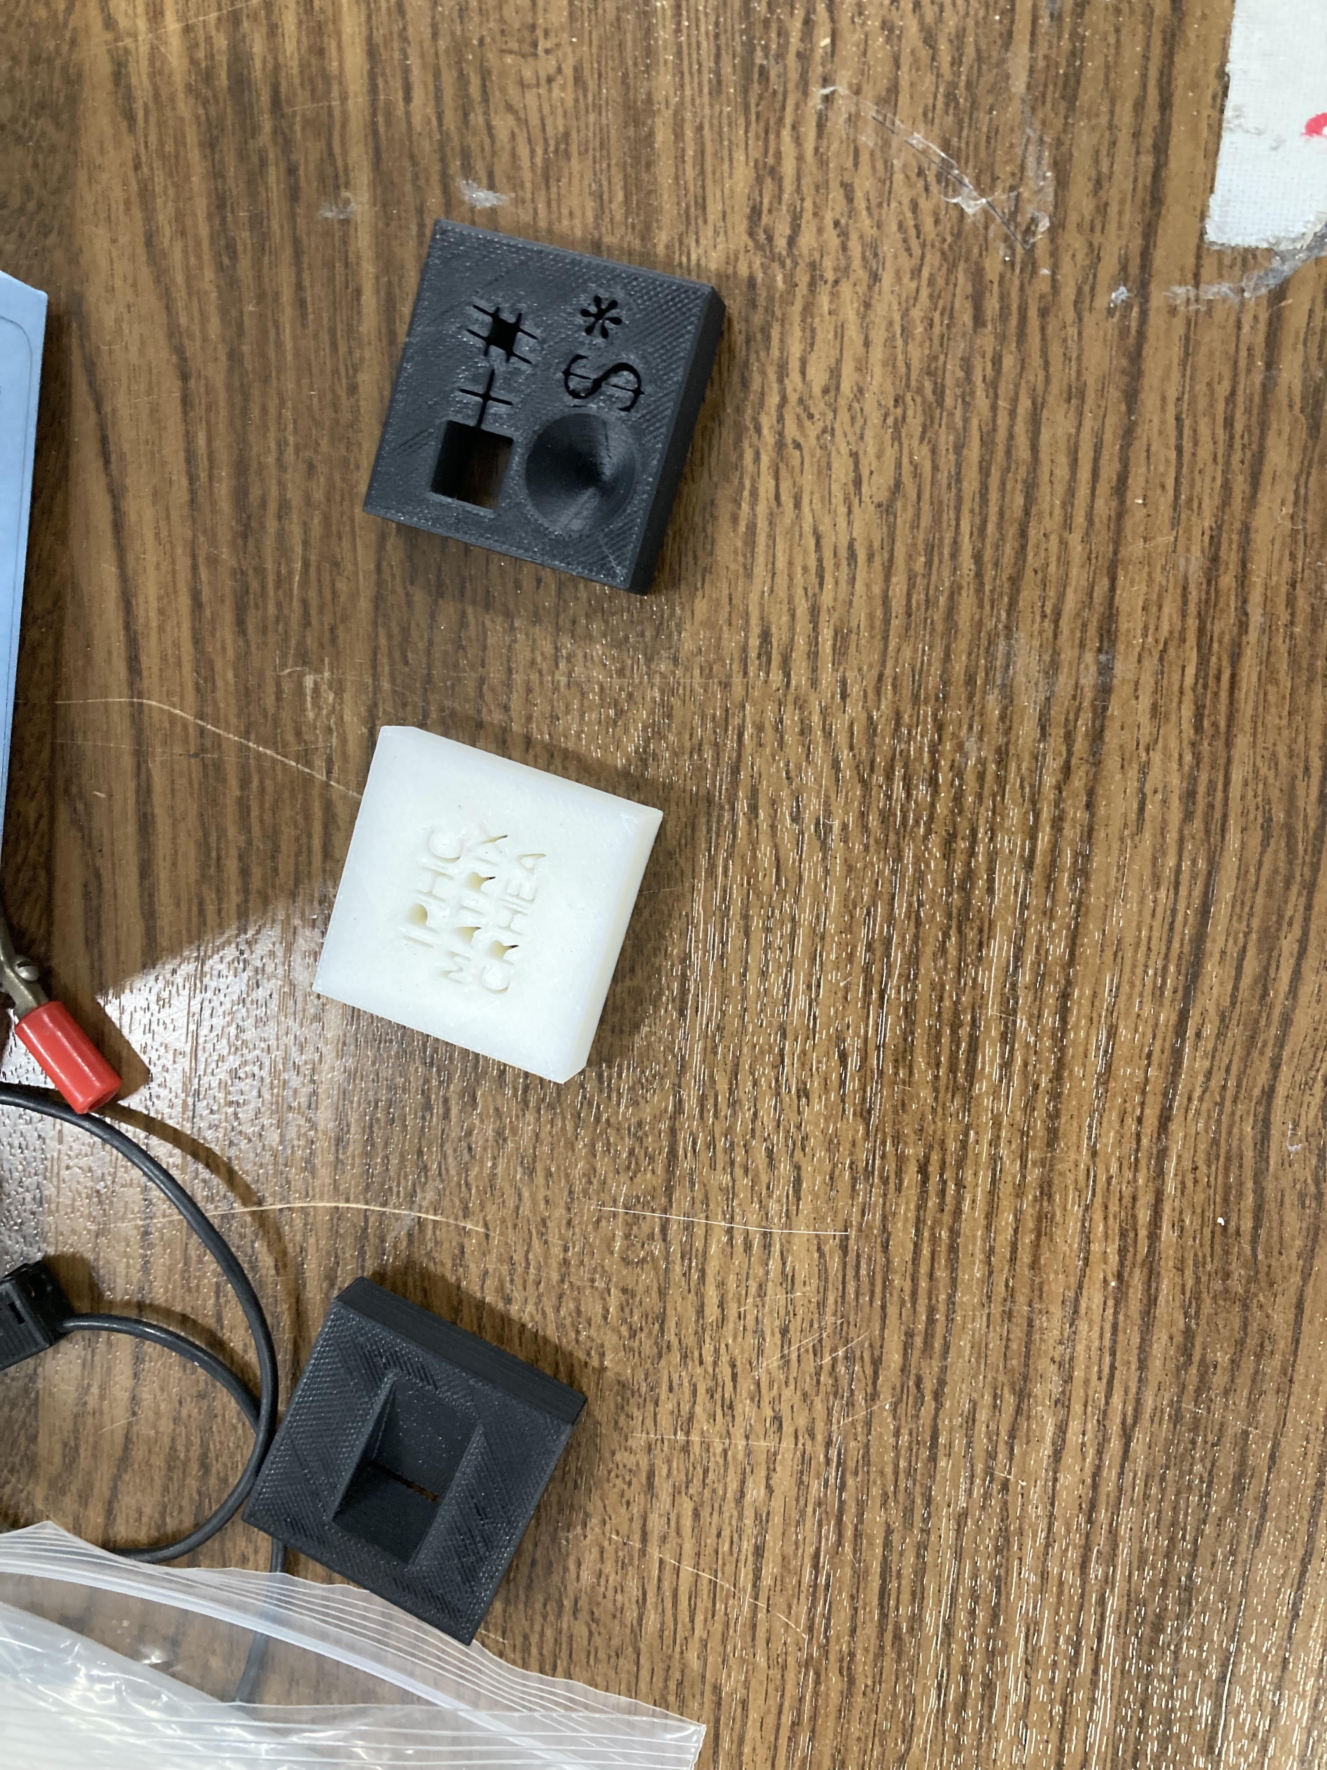
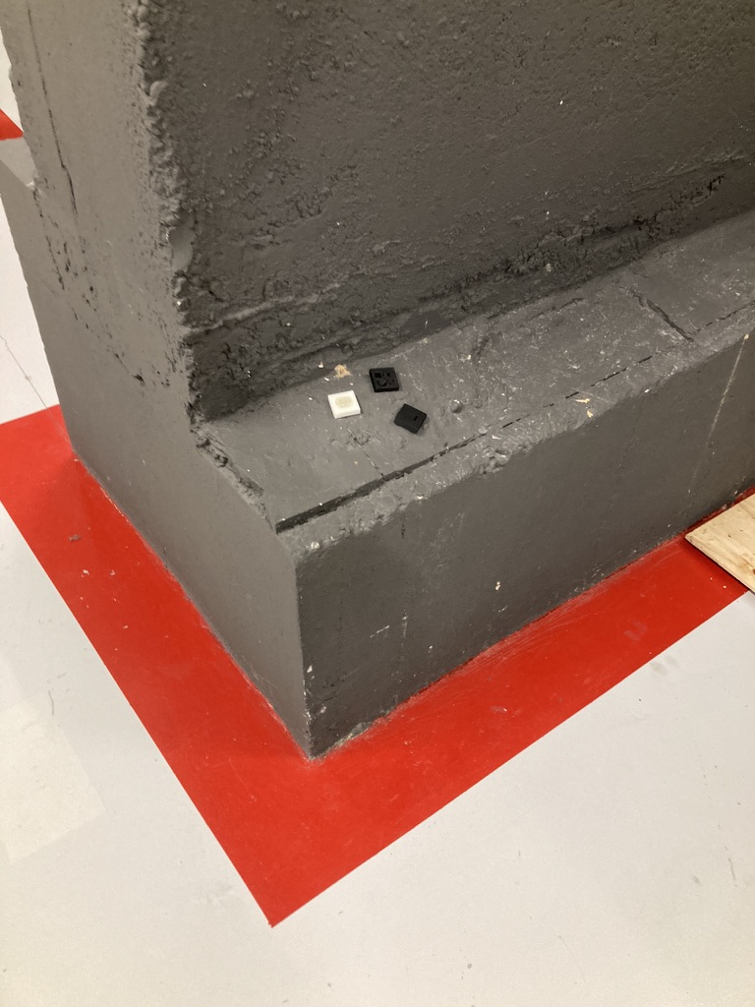
The Logo
4 images (over lunch)
y = 55 mm: 2.43 nA ->
y = 65 mm: ->
y = 75 mm: ->
y = 85 mm: –> 2.33 nA
Beam was stable enough to
do automatic measurement
The logo shape got a proton burn

Slide 40
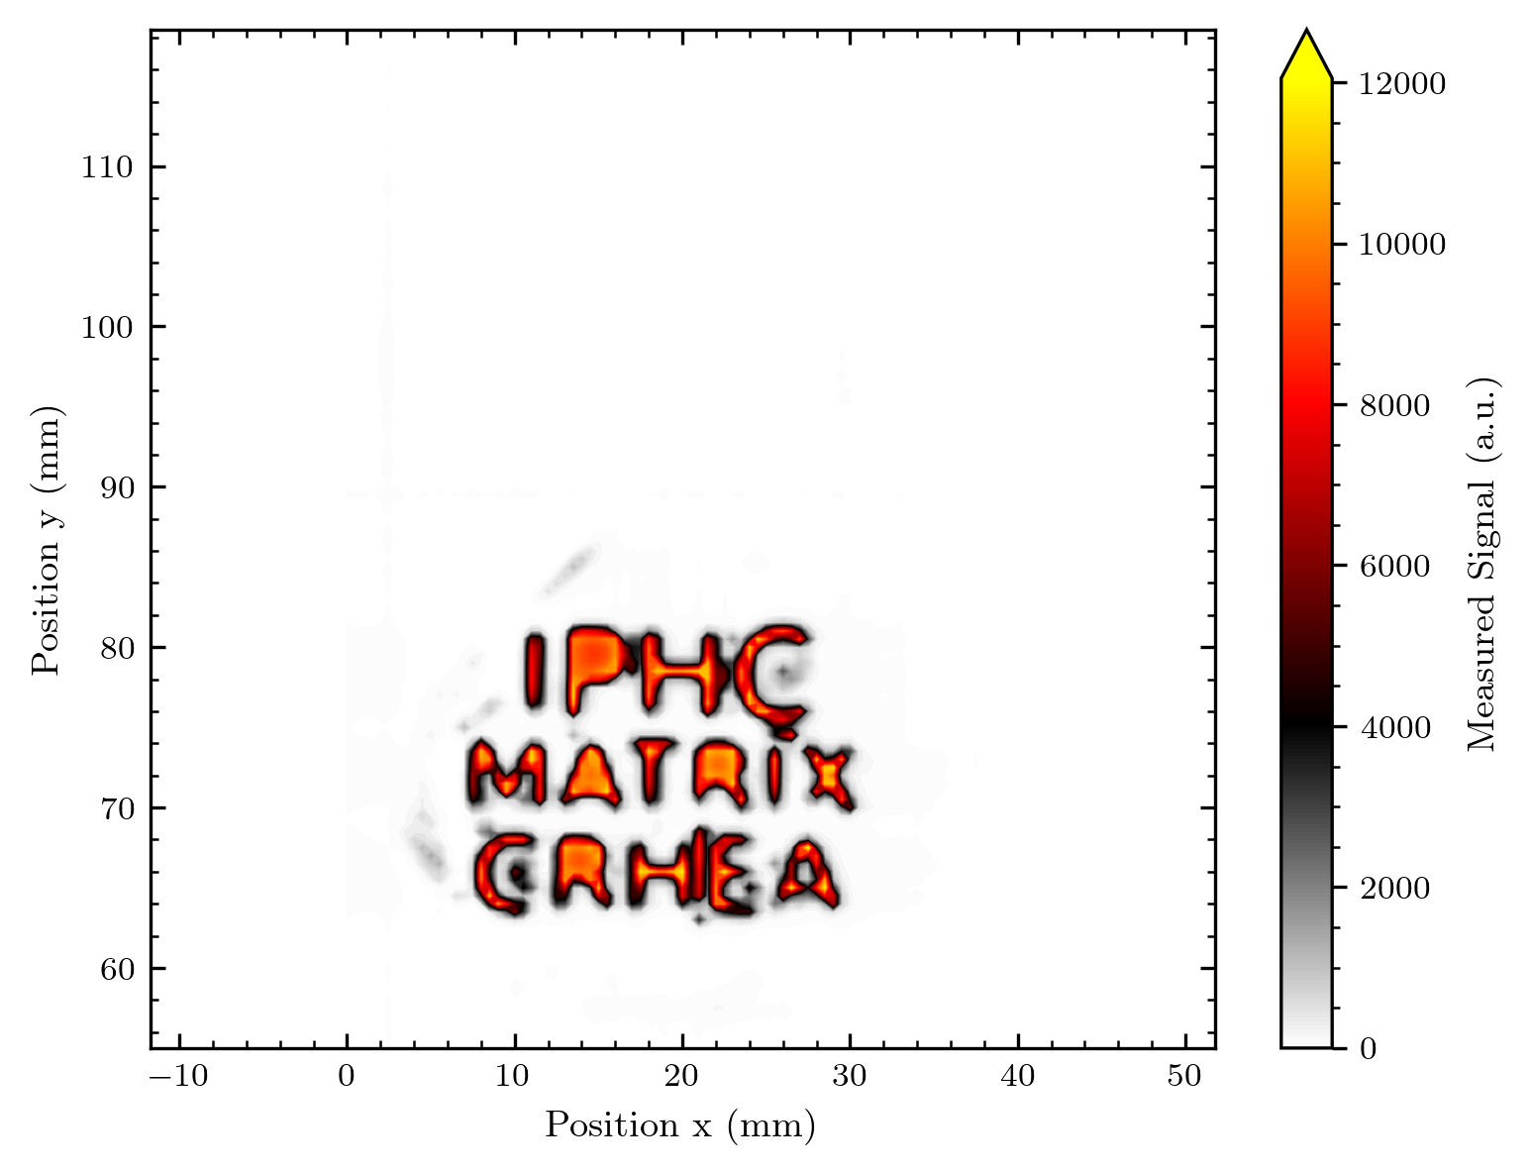
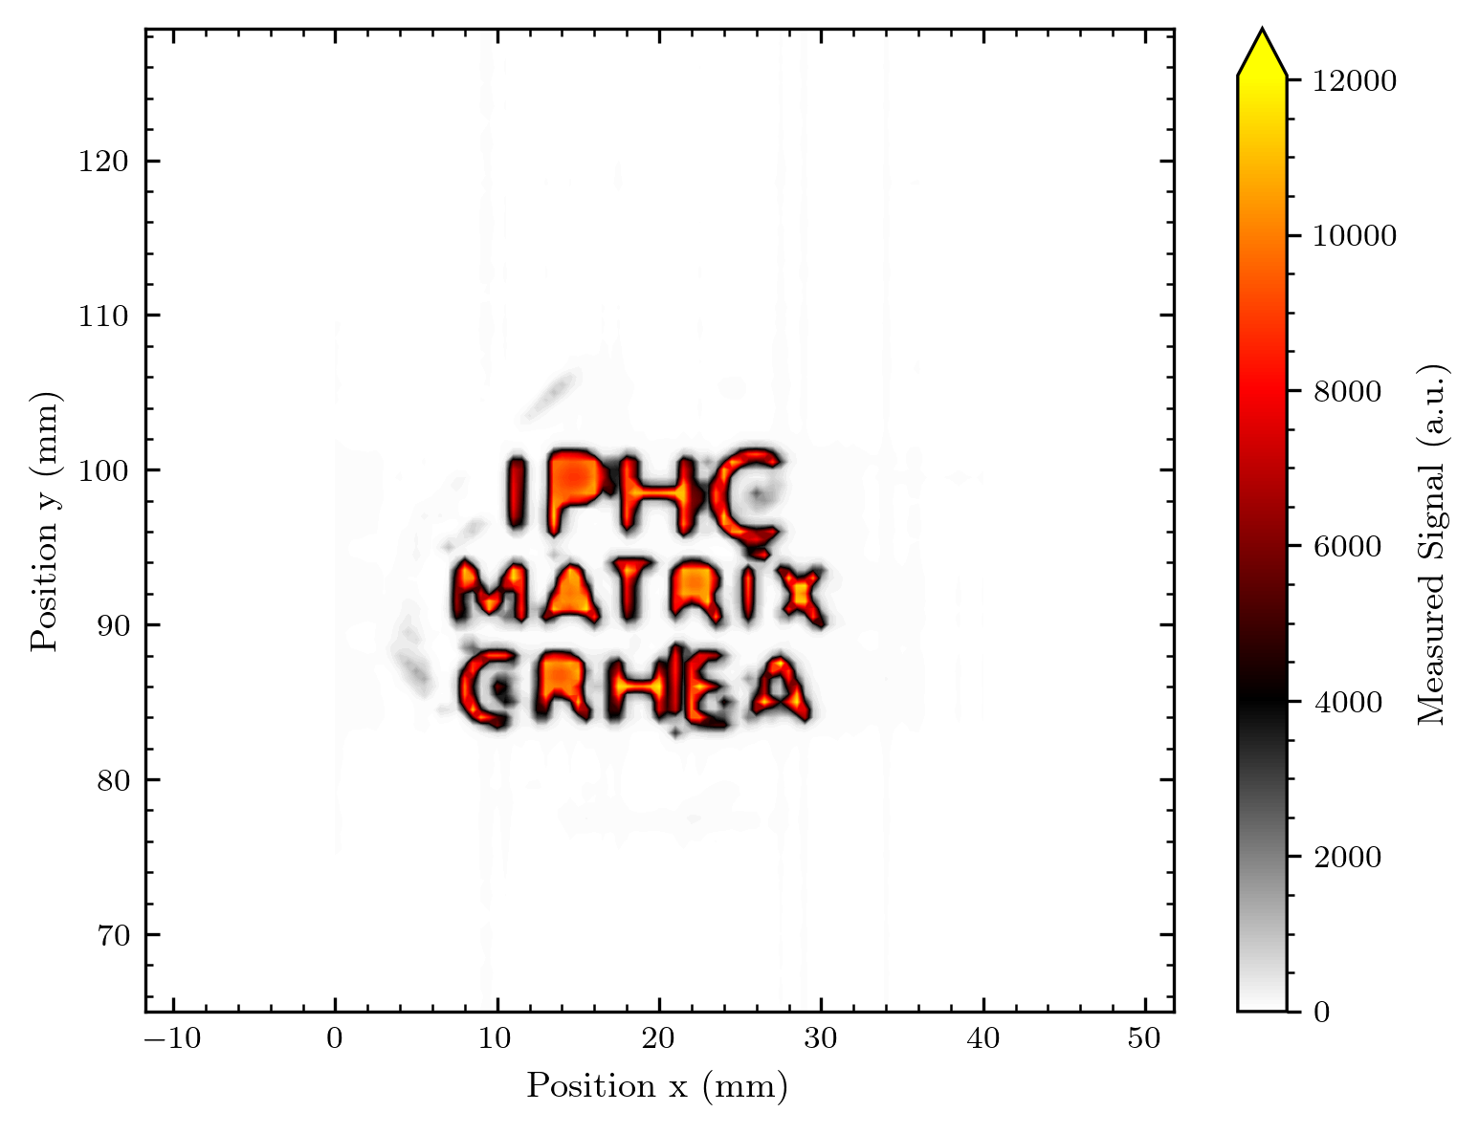
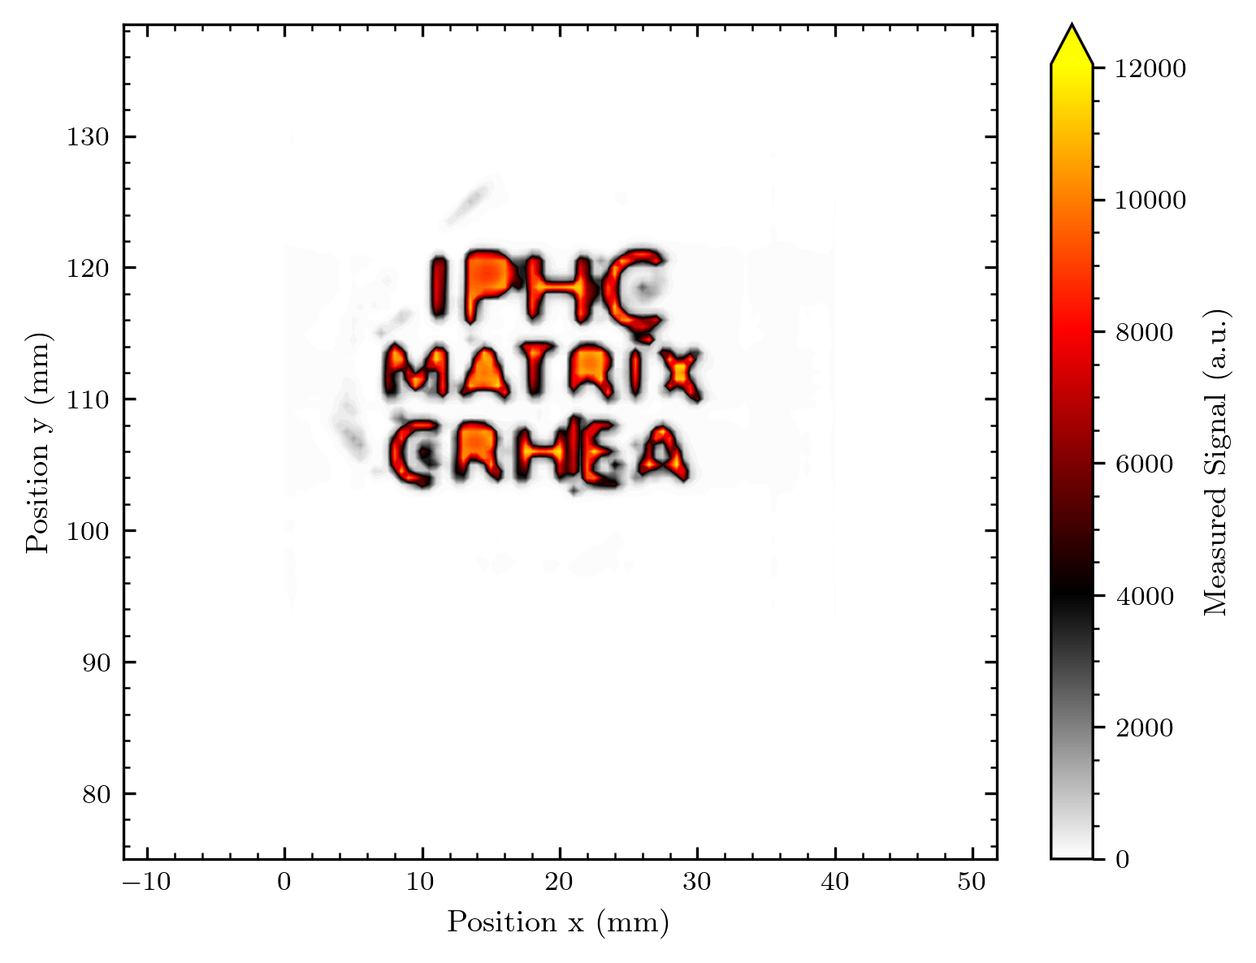
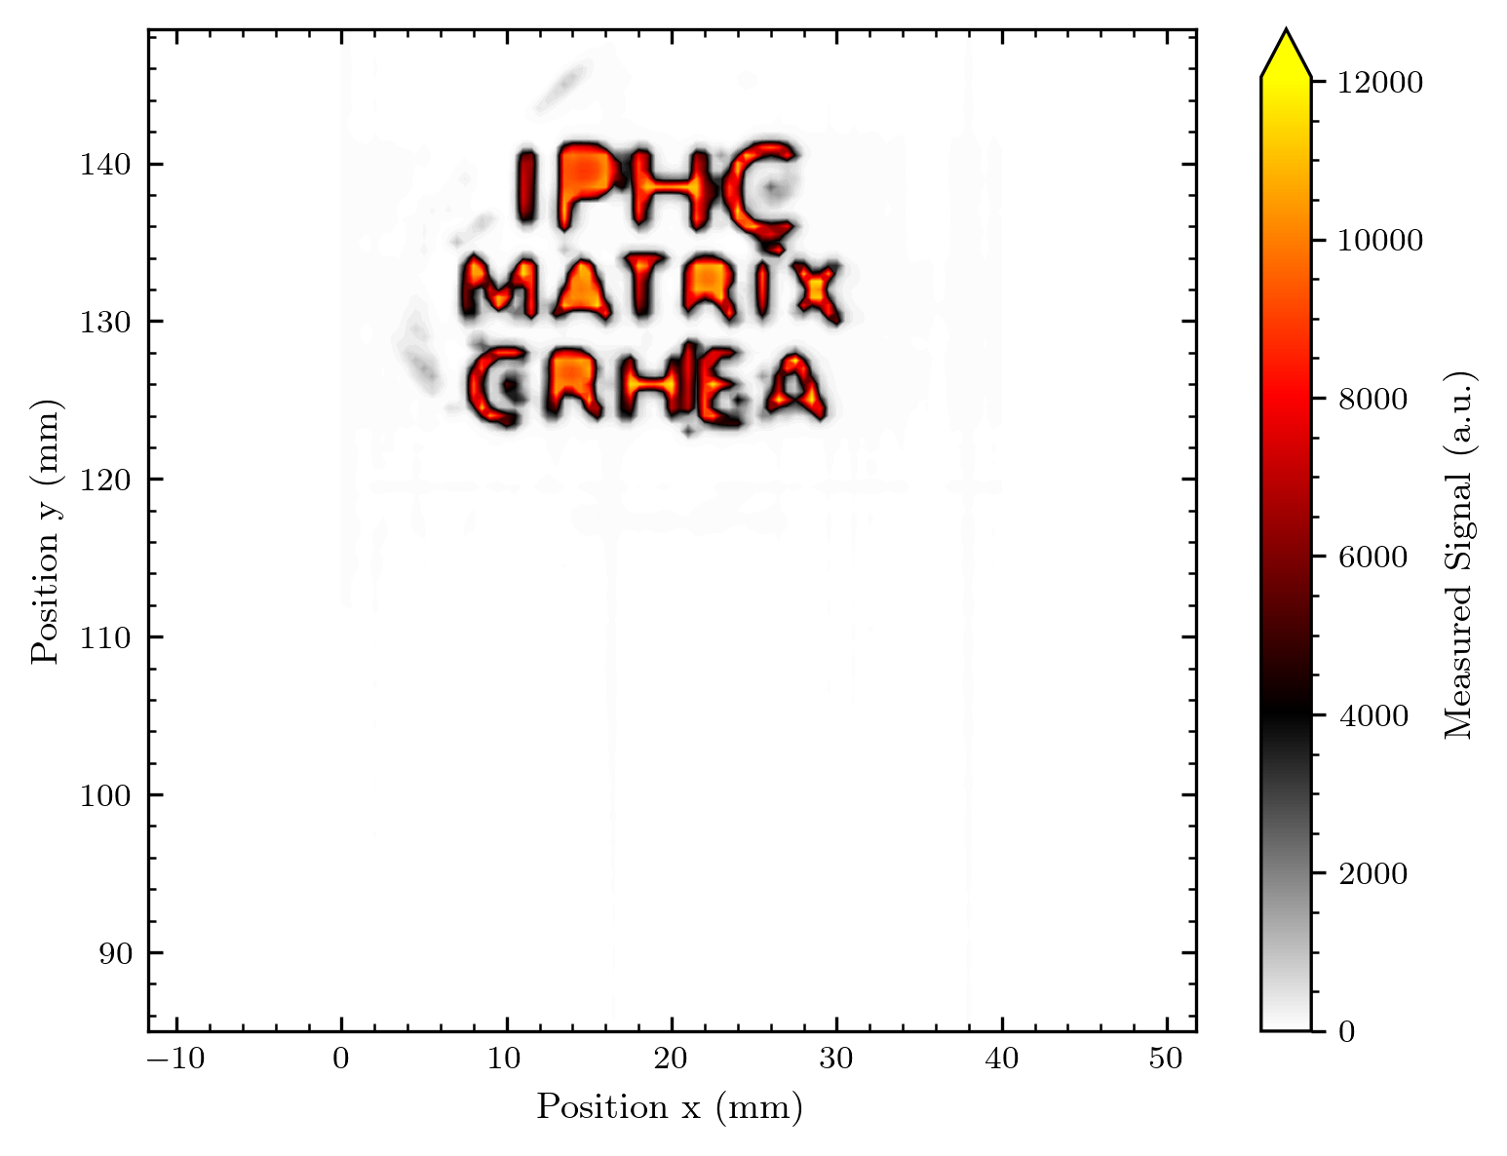

Slide 41
The misc shape
Shadowing of the effectively smaller ~ 30 mm aperture
4 images (over lunch)
y = 55 mm: 2.43 nA ->
y = 65 mm: ->
y = 75 mm: ->
y = 85 mm: –> 2.33 nA
Beam was stable enough to
do automatic measurement

Slide 42
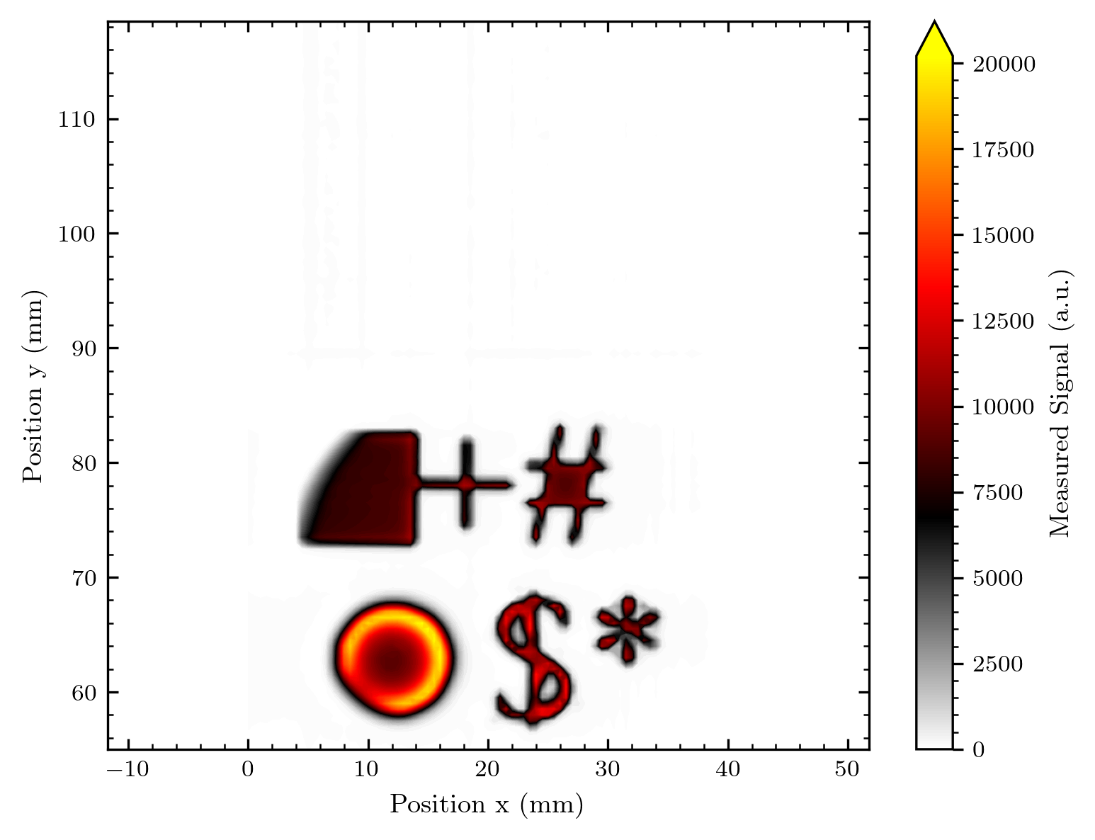
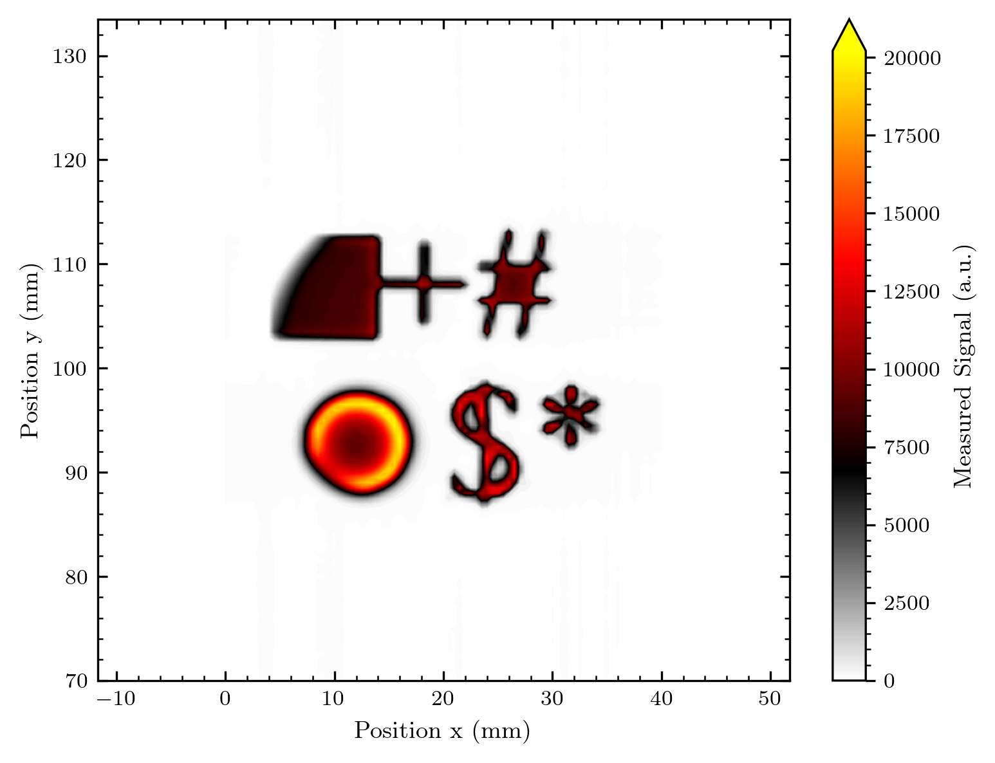
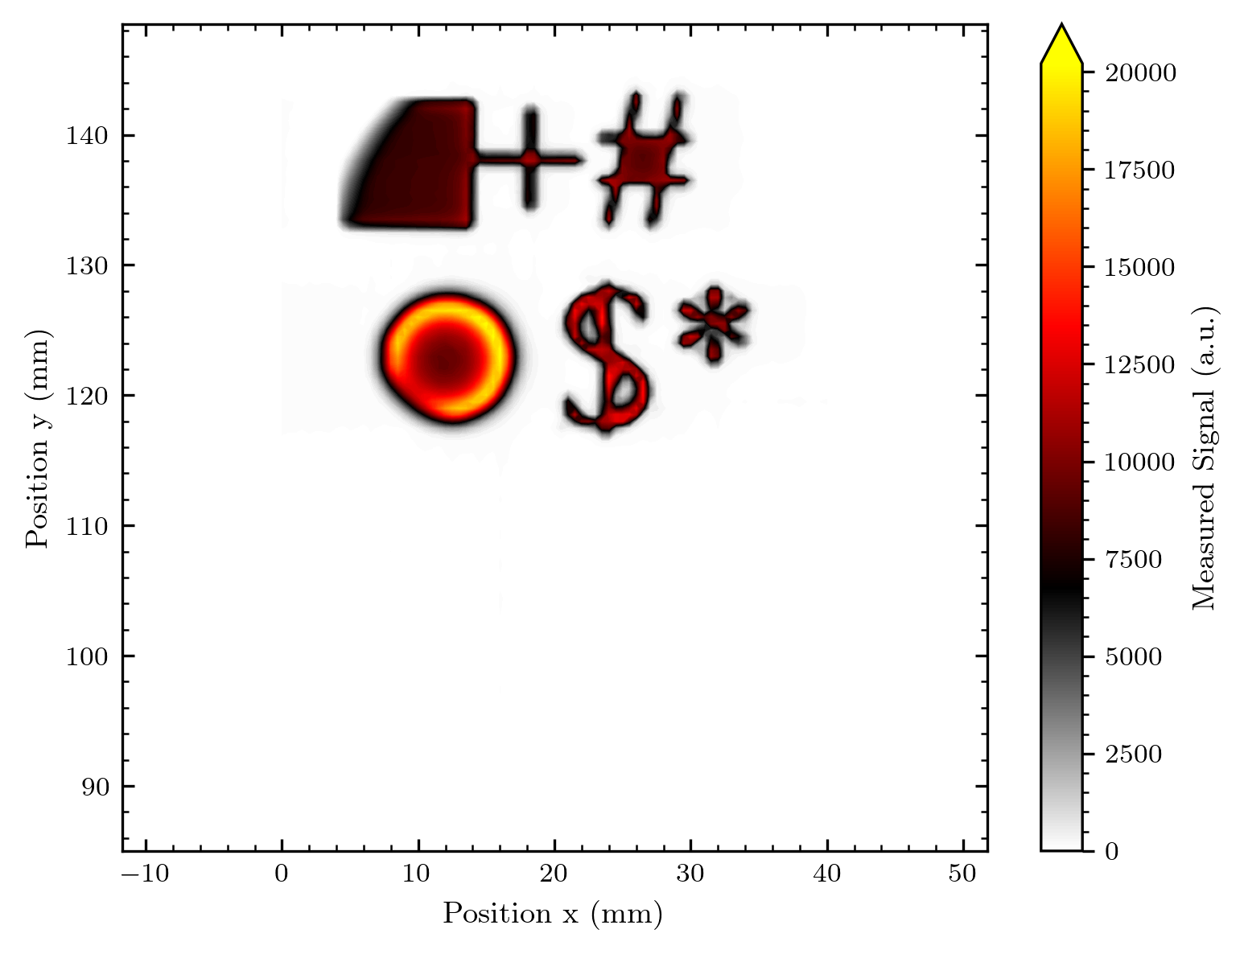

Slide 43
The beam shape without diffuser
We actually see a change in the beam between measurement 2 and 3 – this is a prove of our beam imaging ability. Maybe we can make some timelapse of the beam on the next measurement day!

Slide 44
Beam imaging without diffuser
3 images
y = 55 mm: 2.0 nA -> 1.91 nA
y = 70 mm: 2.0 nA -> 1.95 nA
y = 85 mm: 2.0 nA -> 1.97 nA
Currents at Faraday cup
No diffuser, thus = at sample (if not for the additional collimator in the beamline)

Slide 45
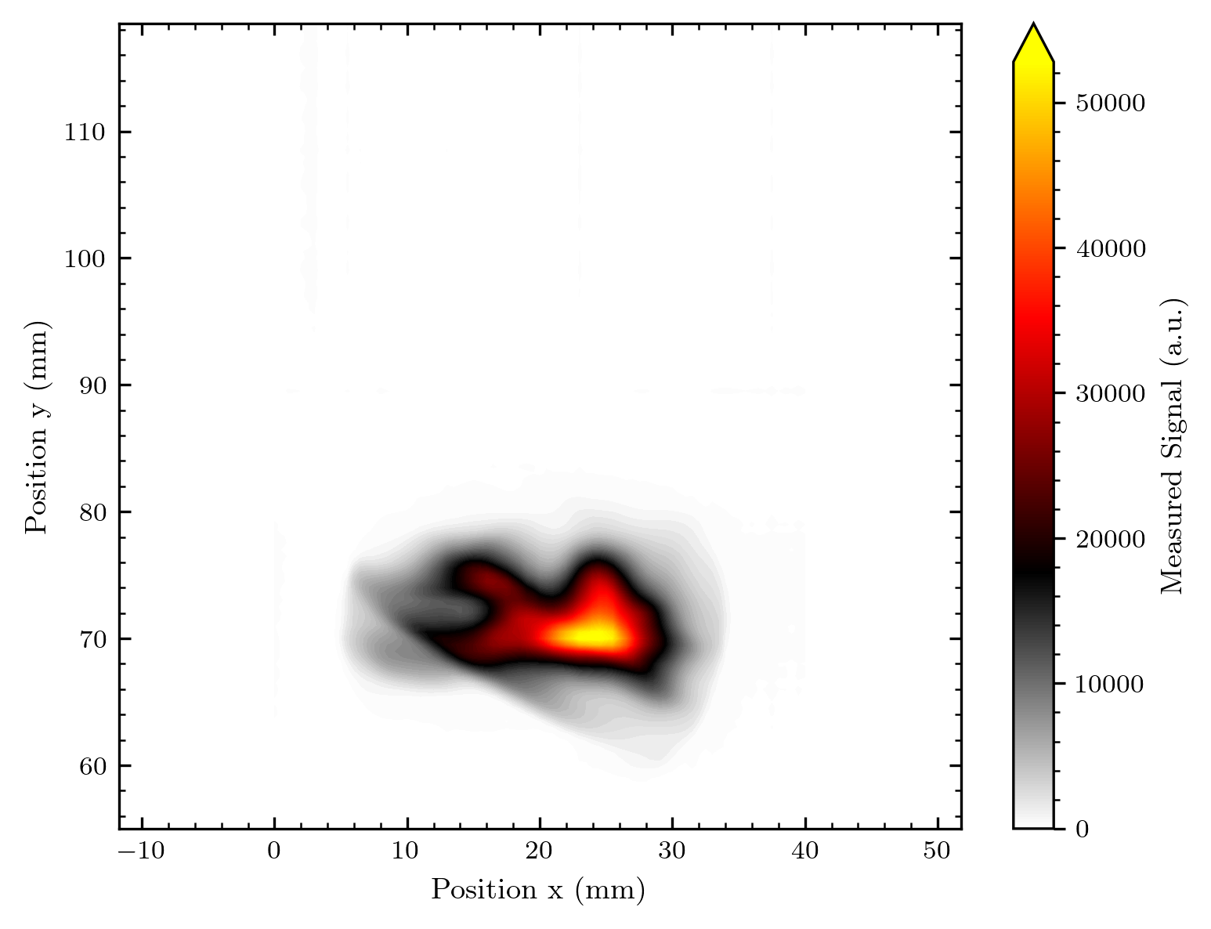
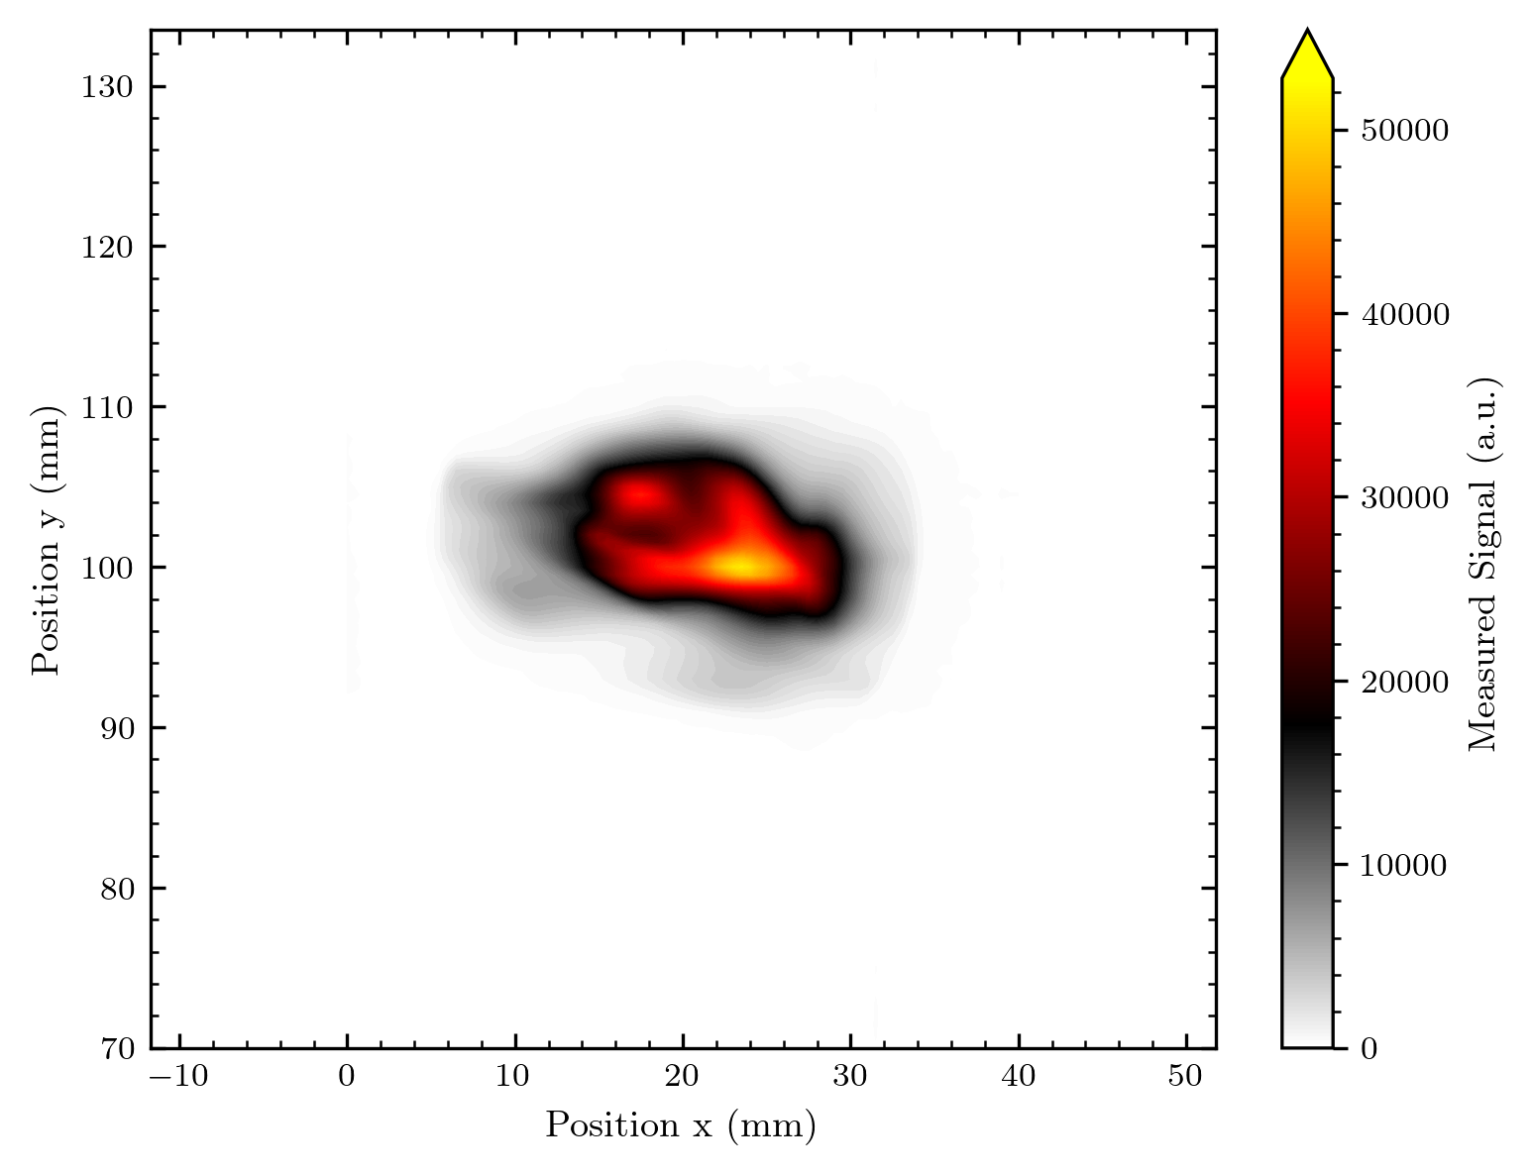
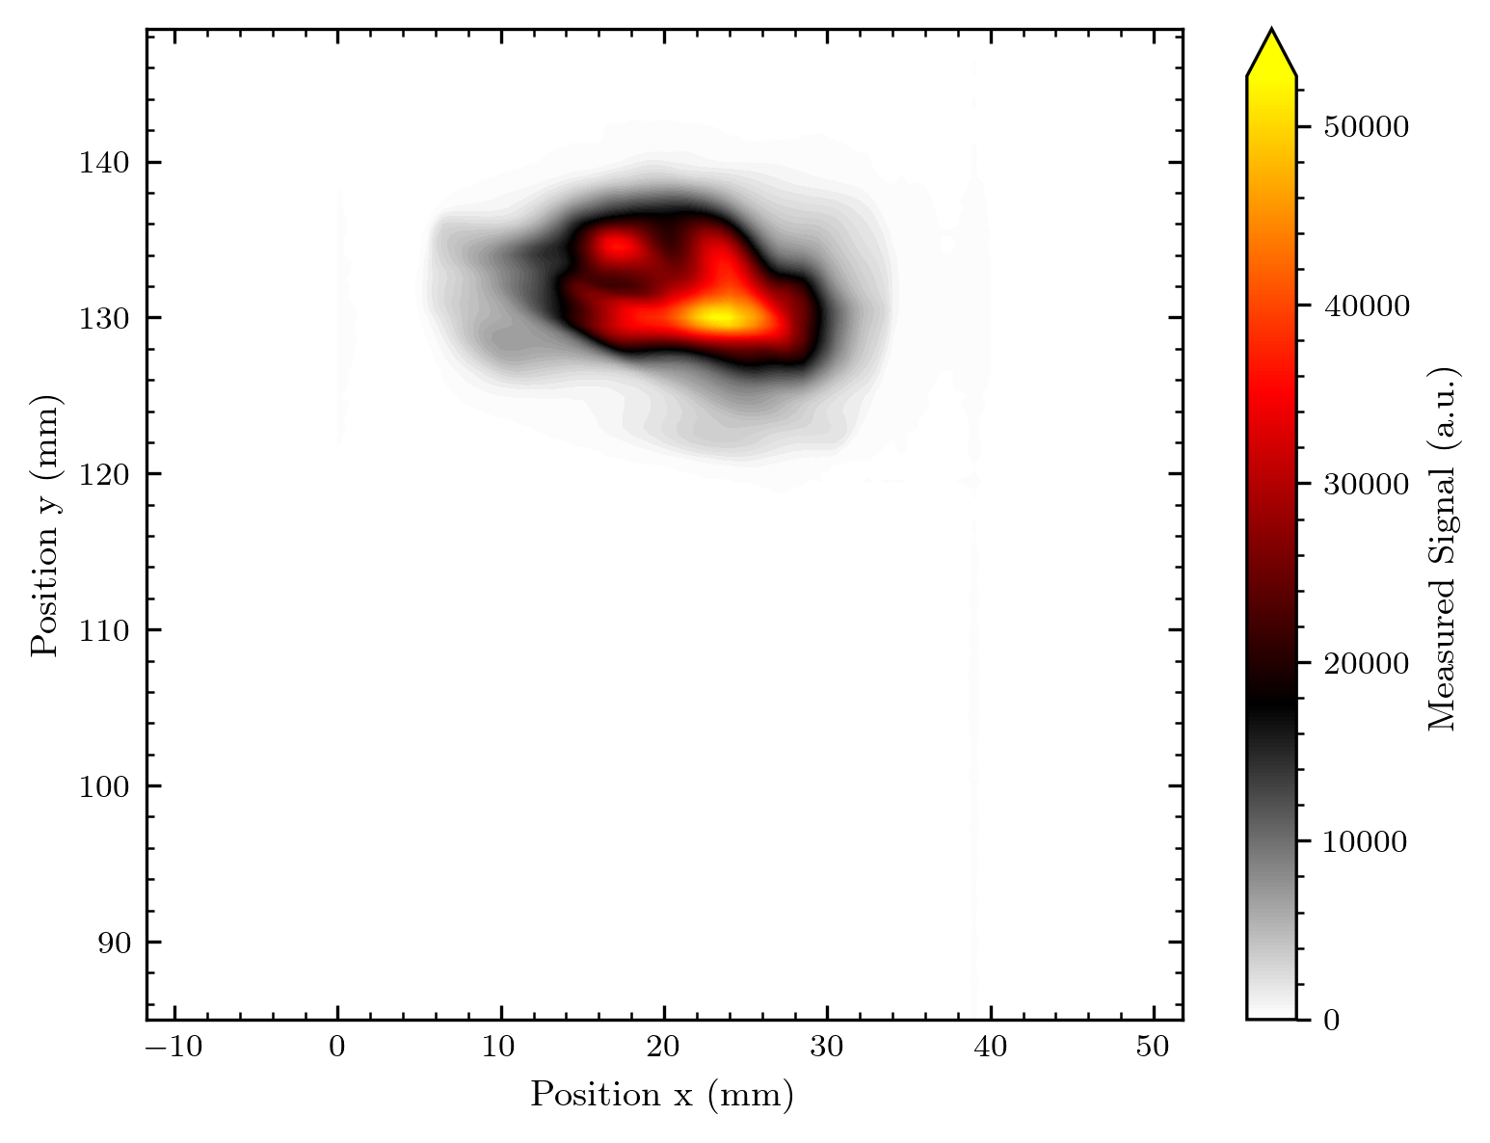

Slide 46
The Bragg peak (only 1 map, but y translated data)
Map at y = 70 mm
2.44 nA -> 2.44 nA
Y-scan
2.44 nA -> 2.44 nA

Slide 47
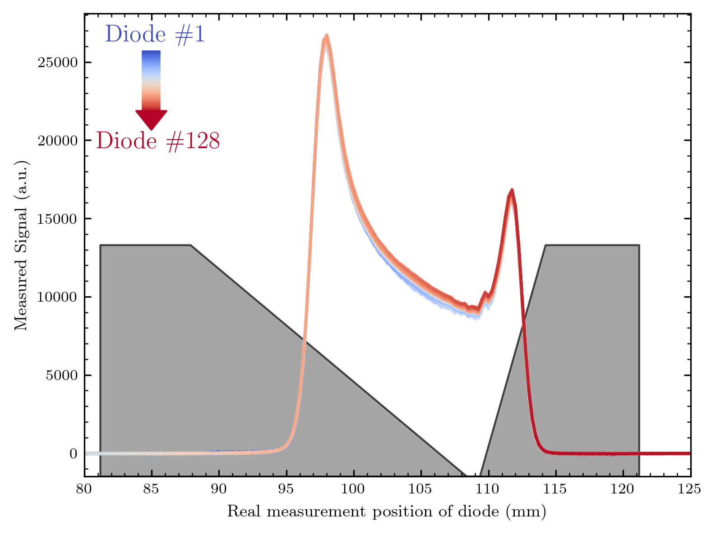

Slide 48
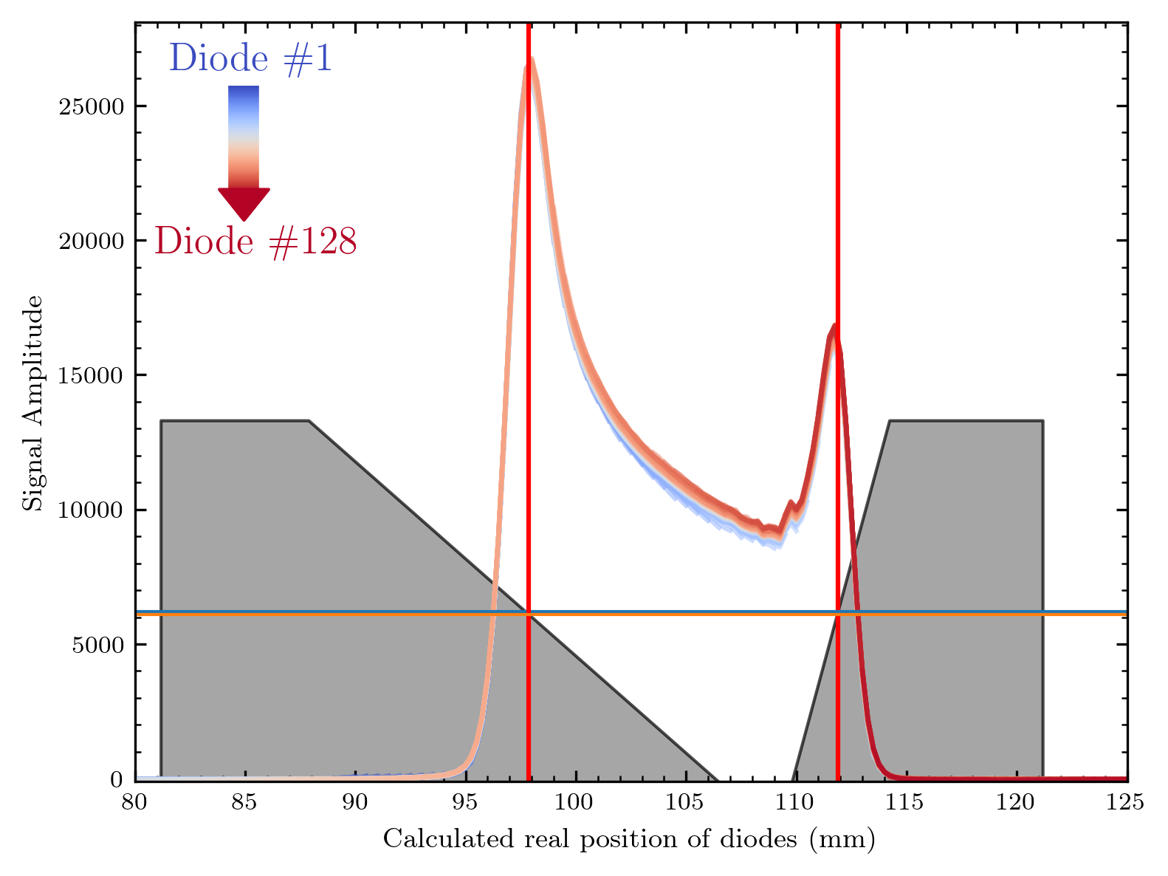
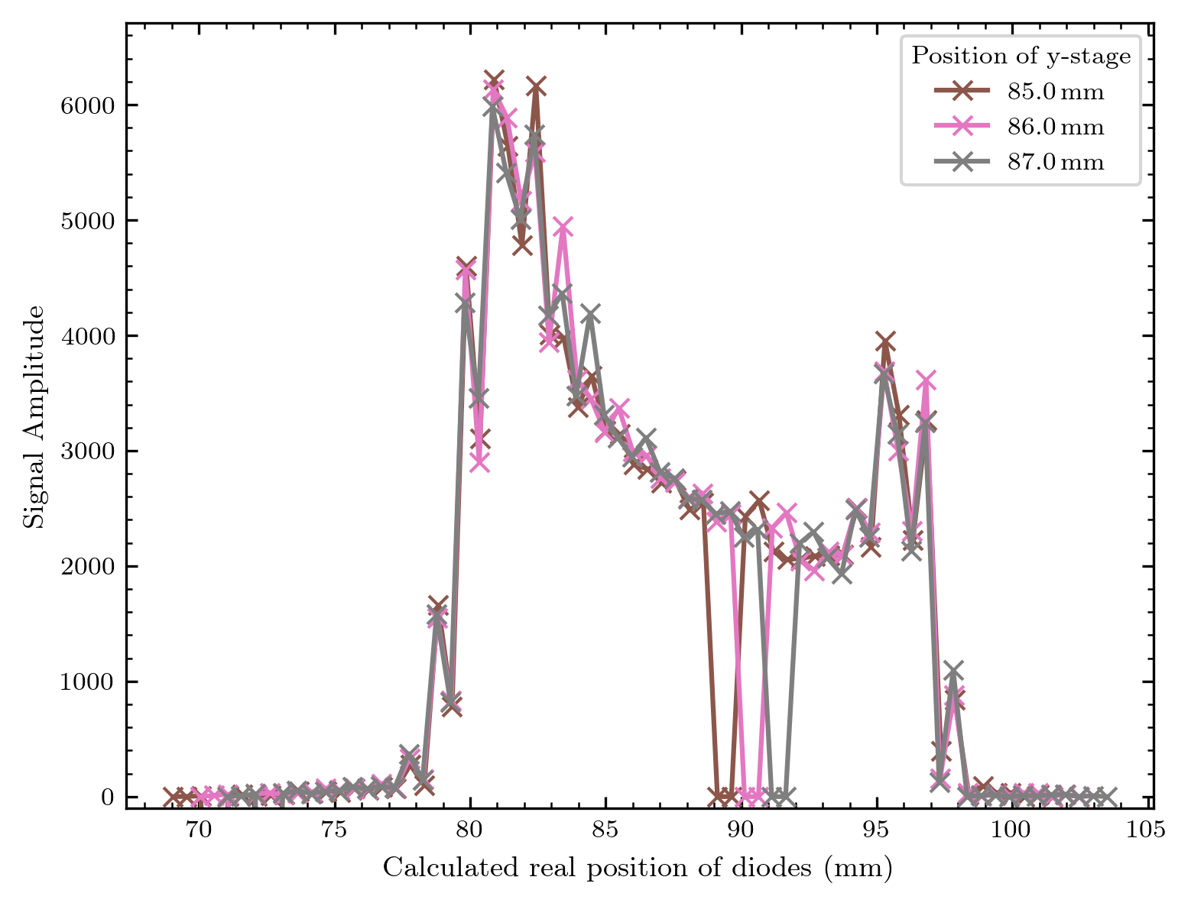
Comparison to previous measurements
without fanout on GaN wafer
with fanout on GaN wafer

Slide 49
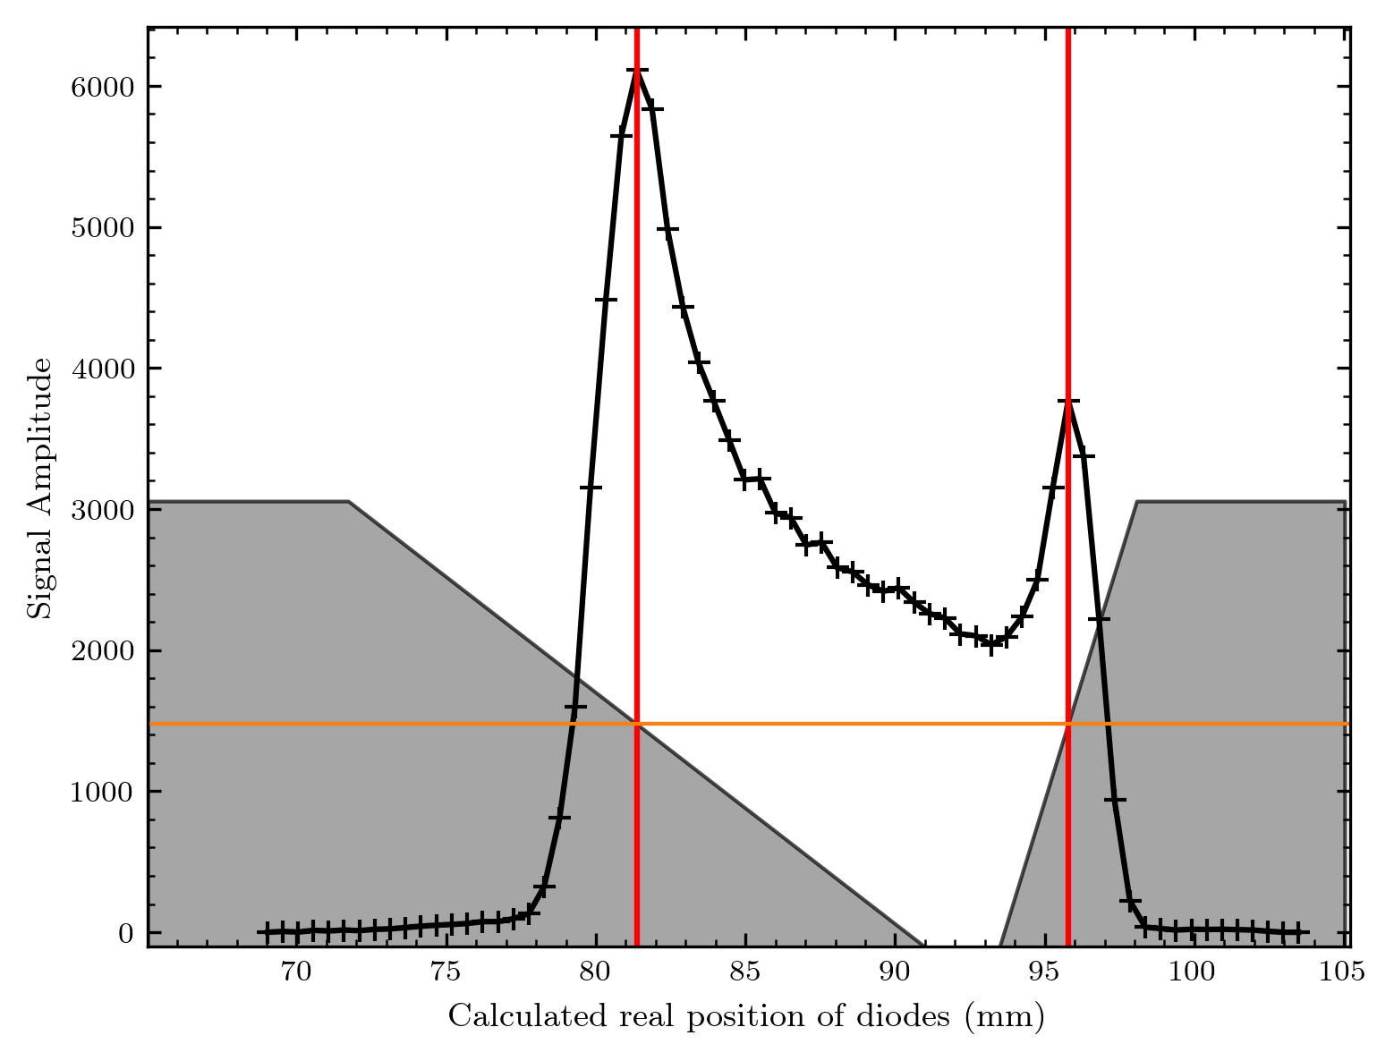
Trapezoid positioning
Latest measurements
Previous measurements
material thickness for max signal: ca. 5.3 mm
(Difference will probably arise from signal swap)
material thickness for max signal: ca. 5.15 mm

Slide 50
Array 3 – higher resolution?

Slide 51
Logo Array 3
This was the last measurement of the day, and with the correct set voltage of 1.8 V
Map at y=85
2.45 nA -> 2.42 nA
There was one diode maybe not working down here, thus we scanned the image in the upper array part!

Slide 52
Smaller diodes 0.25 mm in scan direction + 0.25 mm steps
0.5 mm diodes + 0.5 mm steps
Looks successful, note that the signal is also nearly exactly halved (as supposed to happen)

Slide 53
Beam Shape Array 3
Map at y = 85 mm
2.0 nA -> 1.9 nA
(without diffuser)
But with set voltage 1.0 V…
(I explain at the voltage scan
section)

Slide 54
Smaller diodes 0.25 mm in scan direction + 0.25 mm steps
0.5 mm diodes + 0.5 mm steps
Quite some change of the beam within our measurement day!
Note that we cannot compare the signal here due to the different set voltages!

Slide 55
What is coming in the next days
Analysis of voltage scans (signal, noise, signal to noise)
Analysis of y-translated measurements (how homogeneous is diodes response?)
Normalization from y-translated measurements
More details, image overlay?
Bragg analysis and comparison with previous results
Beam info I got from the Cyrcé crew (finally also for previous measurements) - comparison
Suggestions for next measurements

Slide 56
Normalisation
Details to changes in the method

Slide 57
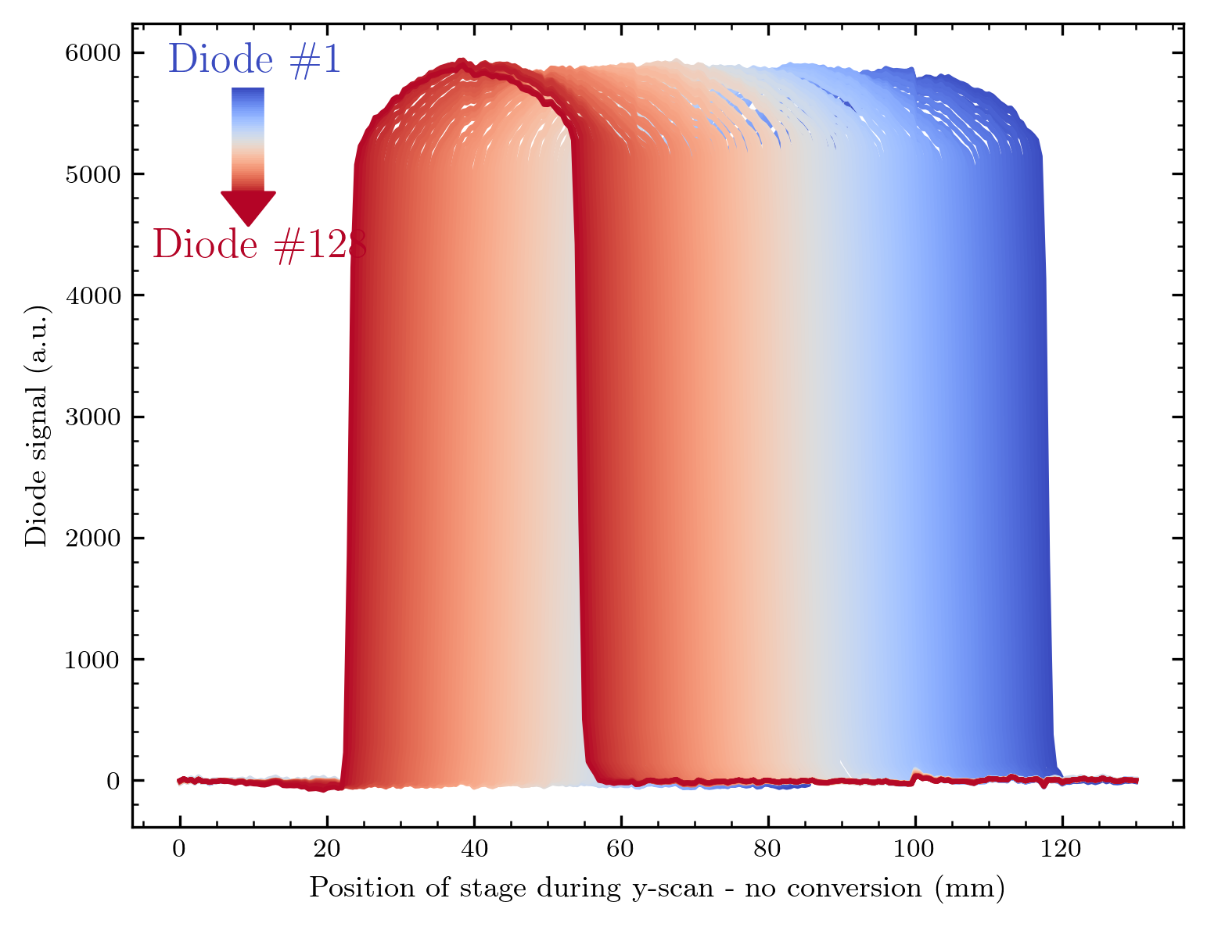
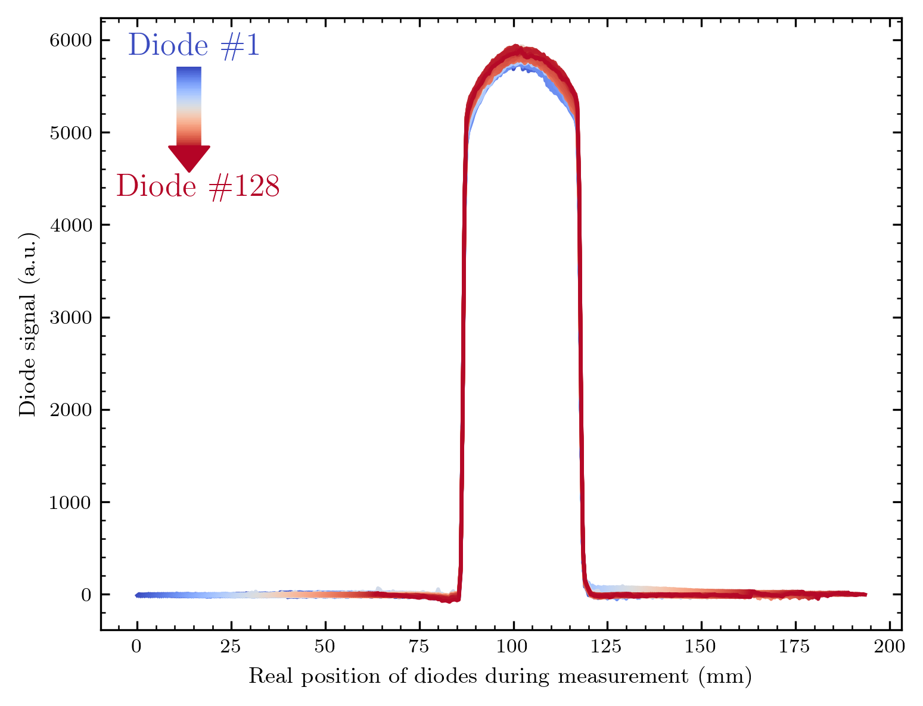
Normalisation Method
As before, the signal of a diode is calculated at each stage position by considering the array geometry. Note how perfect this shift is here!

Slide 58
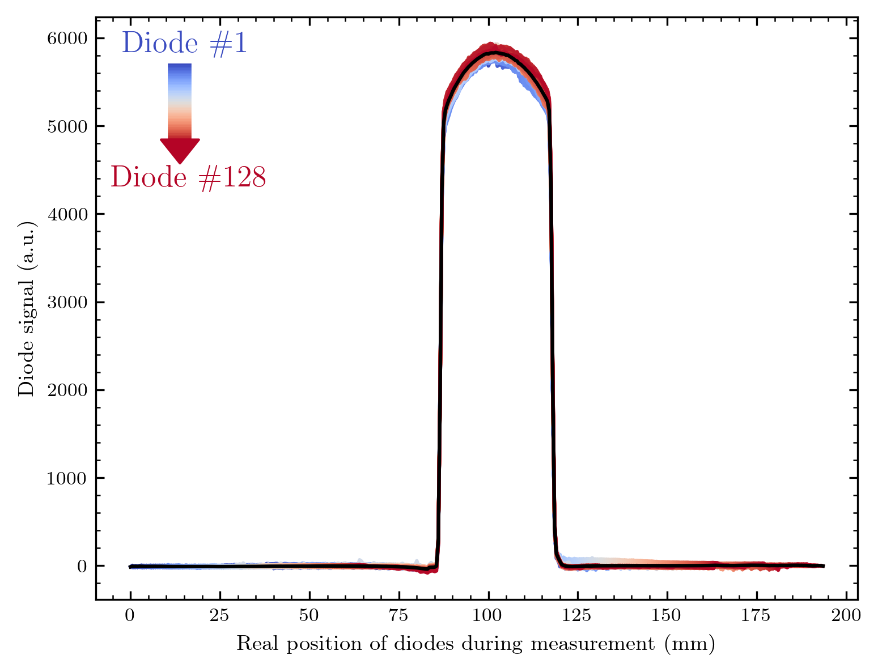
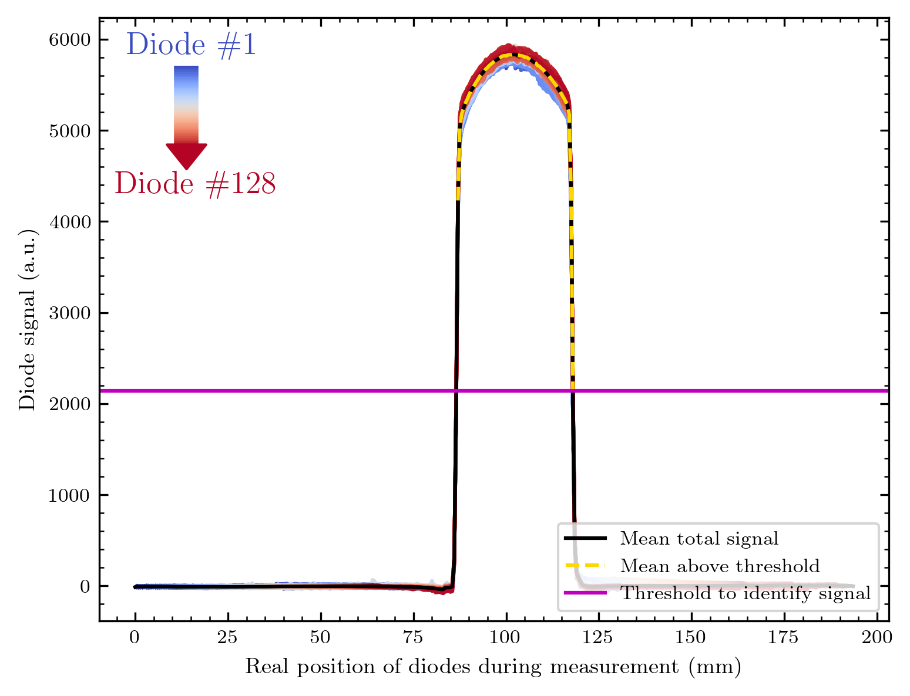
Method changes
The mean is calculated by grouping the diodes into positions close to each other (the calculated real positions are not necessarily aligning). This mean of each position is now limited to a signal region. The corresponding threshold is calculated – as usual – with Otsu‘s method.

Slide 59
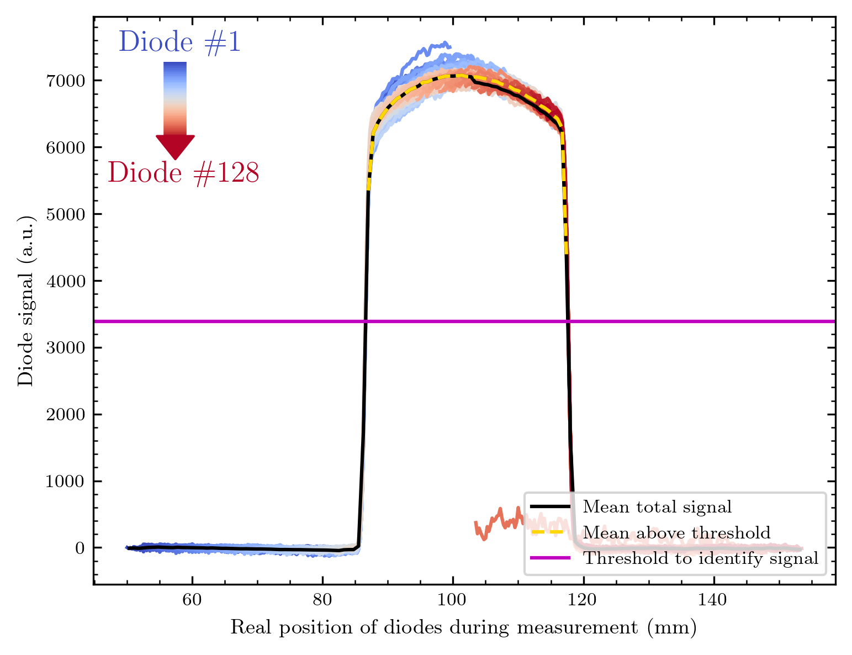

Why this limit to signal region above threshold?
If not considering the signal above a threshold – one not working diode is impacting the calculated mean. The mean from the new method is able to avoid this problem.

Slide 60
Results y-translated measurements
What was measured?
How uniform are the diodes?
How good is the normalisation factor?
Comparison to factor from the previous measurement

Slide 61
What was measured
Array 1:
In the morning – y translated scan through the middle of the round aperture. Every diode passed completely through the signal!
BUT: The signal decreased from 2.43 nA to a current below 2 nA, we do not know how it decreased during measurement …
Later: Scan with a smaller window, every diode in the beam, but not completely through the beam (due to time management)
Current decreased from 2.44 nA to 2.43 nA.
Array 3:
One scan with same parameters to second scan of Array 1.
Current: 2.45 nA – 2.45 nA
But voltage setpoint at 1.0 V instead of the 1.8 V we chose earlier!
I will present the three results in this order!

Slide 62

Scan with decreased current?
The response is very homogeneous – I cannot really identify the drastic decrease in beam current

Slide 63


Scan with more stable current?
Still very homogeneous – but not as stable?? as before. (The measurements cannot be switched, the beam current was nearly stable here…) Why the diodes tend to show lower signal here is unclear to me so far

Slide 64
Comparison
In both cases we scanned upwards, meaning each diode's signal on the left was measured first, the one for high y-values (on the x-axis) later on.
The signal is indeed lower for the left scan, which would correspond to the lower beam current. Maybe the beam current dropped after starting the scan and remained nearly constant?
Could we see degradation effects on the right side?

Slide 65


I calculate a factor for both of these and shift the diodes‘ curves correspondingly

Slide 66


Factors and comparison
We are, in each case, inside ~ 6 % homogeneity in the response!
There is a difference between the 2 normalization measurements, but some parts of the factor are identical – this is also nice proof of the stability in the diode response.

Slide 67

Scan Array 3; also stable current – different voltage setpoint
Also, very homogeneous, maybe a bit worse than the other array? Here is one not working diode – the only one of both arrays. This means Matilde reached an efficiency of ~ 99,6 % ☺

Slide 68


Shift back with factor
This was the reason I needed to rewrite the normalization

Slide 69


I also want to compare the 2 arrays (and all 3 measurements)
The results are impressive in each case.
As discussed, the signal of Array3 is influenced by the different set voltage of 1 V.
We are in a range of ~ 6 % homogeneity for the 2 arrays!

Slide 70
Now: Compare with older measurement!

Slide 71

This is the best Y-calib scan we made last time.
The response is much lower.
From the logbook, these measurements had 1 nA
current, meaning the half of the 2 we had now.
But the setpoint voltages were different:
1.8 now, 2 V back then.

Slide 72

Comparing the factors
The homogeneity we reached now among one array
is ~ factor 20 times better than before!
Before: Factor from ~ 0.6 to ~ 1.8 -> 1.2 range
120 % deviation in response
Now: ~ 0.96 to ~ 1.02 -> 0.06 range
6 % deviation in response

Slide 73
Is the new normalisation even necessary?
We talk about a signal correction in the percent region…
I add comparisons of maps without (left) and with (right) the new factor correction.

Slide 74
Round aperture

Slide 75
Logo

Slide 76
Misc

Slide 77
Beam Scan

Slide 78
Array 3 Logo

Slide 79
Array 3 Beam Scan

Slide 80
I‘d say the differences are very small, but visible for especially the round aperture. Seems like the normalisation is still able to improve the homogeneity in signal for the maps!

Slide 81
Voltage Scan
From 0 - 2 V for both arrays.
Comparison with old voltage scan
Signal = Mean from measurement
Noise = Std from measurement
Signal and dark are clear I guess

Slide 82


Results Array 1 and Array 3 - Dark
The signal current saturates under 1 V , thus I will only show the interesting region from now

Slide 83


Results signal

Slide 84


Comparison in one graph

Slide 85


Ratios and netto signal

Slide 86


Is the signal ratio between the arrays 2?
Actually no, only 2 for 1.8 V which explains the nice scale of the logo plot. To me a bit unclear, because half the diode size should mean half the diode active region, shouldn‘t it? Is there a deviation in the arrays IV-curves?

Slide 87
IV-curves
Not really differences in voltage characteristics…

Slide 88

Old measurements
We made one scan of the old array e1.
From the logbook and file name, the proton current was set to 300 pA. But the signal is far too high for this – thus I will not compare this scan with the new ones…
But we have made a linearization scan at 2 nA for 1 V and 2 V with this array, giving me at least 2 points to compare!

Slide 89


Comparison - old and new arrays

Slide 90


Comparison - old and new arrays

Slide 91
Why we picked 1.8 V…
Actually by coincidence. We observed a lot of 0s in the data for 2 V. We then checked manually 1.9, 1.8 and 1.7 V without a difference.
The problem was the following: In the measurement code a manually given voltage is set as an integer value, meaning we only observed 2 V or 1 V by changing the value manually.
We came across this for the array 3 measurements – but first modified the wrong part of the code. Therefore, the y-homogeneity scan and beam image were made with 1 V instead of 1.8 V.
The voltage scan suggests that there is not a really big difference in the range from 1 V to 2 V – seemingly each set value would give viable (imaging) quality.

Slide 92


Comparison with diffuser Gafchromic

Slide 93


H
B
G
D
Looks reasonable, even though we see some curvature of the beam. The grey scale scan
looks more or less flat…
I might try to relate the greyscale and signal values based on scaling.

Slide 94

Norm all to 1 and align x-axes to get a quantitative comparison!
Data from Gafchromic extracted with online tool – points aligned by hand
(without investing several hours this at least gives a nice idea of the data curve)
Looks excellent, and it seems that our normed response can be compared to the response of the gafchromic!
H
B
G
D

Slide 95
Ideas and suggestions

Slide 96
Some work of the measurement code
We need to eliminate the set voltage problem.
Maybe integrate all scan options in one routine loop of Stépahnes Tkinter-based GUI.
Integrating a live view for mapped data would be nice, but requires some modifications of my plotting code.

Slide 97
Standard for file naming
I think it might be a good idea to have a standard for the file naming. Currently, the naming is good – but some slight problems still exist.
My suggestion:
{#Number of measurement}_{Short name of measurement / object}_{Diffuser_thickness}_um_{Current at beam level!}_nA_{Set voltage of ams circuit in V}_x_{x pos of stage}_y_{y pos of stage}.csv
e.g.: 1_RoundAperture_200_um_2,43_nA_1,8_x_20_y_70.csv
Thus each measurement is distinct (due to the numbering) and we keep the most important values (easy to parse) in the file name.
Adapting this should be easy with Stéphanes Python script.

Slide 98
Ideas for measurements (with arrays)
We did this already for the older ones, but if we have the time: Signal vs proton current (maybe also for different voltage set points?)
Beam imaging with Gafchromic – and maybe over a longer duration to generate a sort of “beam video“

